Slide 1
En-ROADS Supplemental Slides

Slide 2
About En-ROADS

Slide 3
En-ROADS is a fast, powerful simulation tool for understanding how we can achieve our energy transition and climate goals through changes in our energy use, consumption, and policies
Helps decisionmakers understand the policies and investments that have the greatest impact
A global model, with which decision makers can initiate conversations about the urgency of acting to meet the Paris objectives
Effective for communication, presentation and analysis

Slide 4
Features of En-ROADS
Transparent
  All equations and structure are available
Flexible
  Assumptions are adjustable
Highly aggregated to be fast
  Complementing, not supplanting, the EMF22 and other more detailed models
For grounding discussions to learn and strategize
  Not point predictions

Slide 5
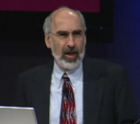
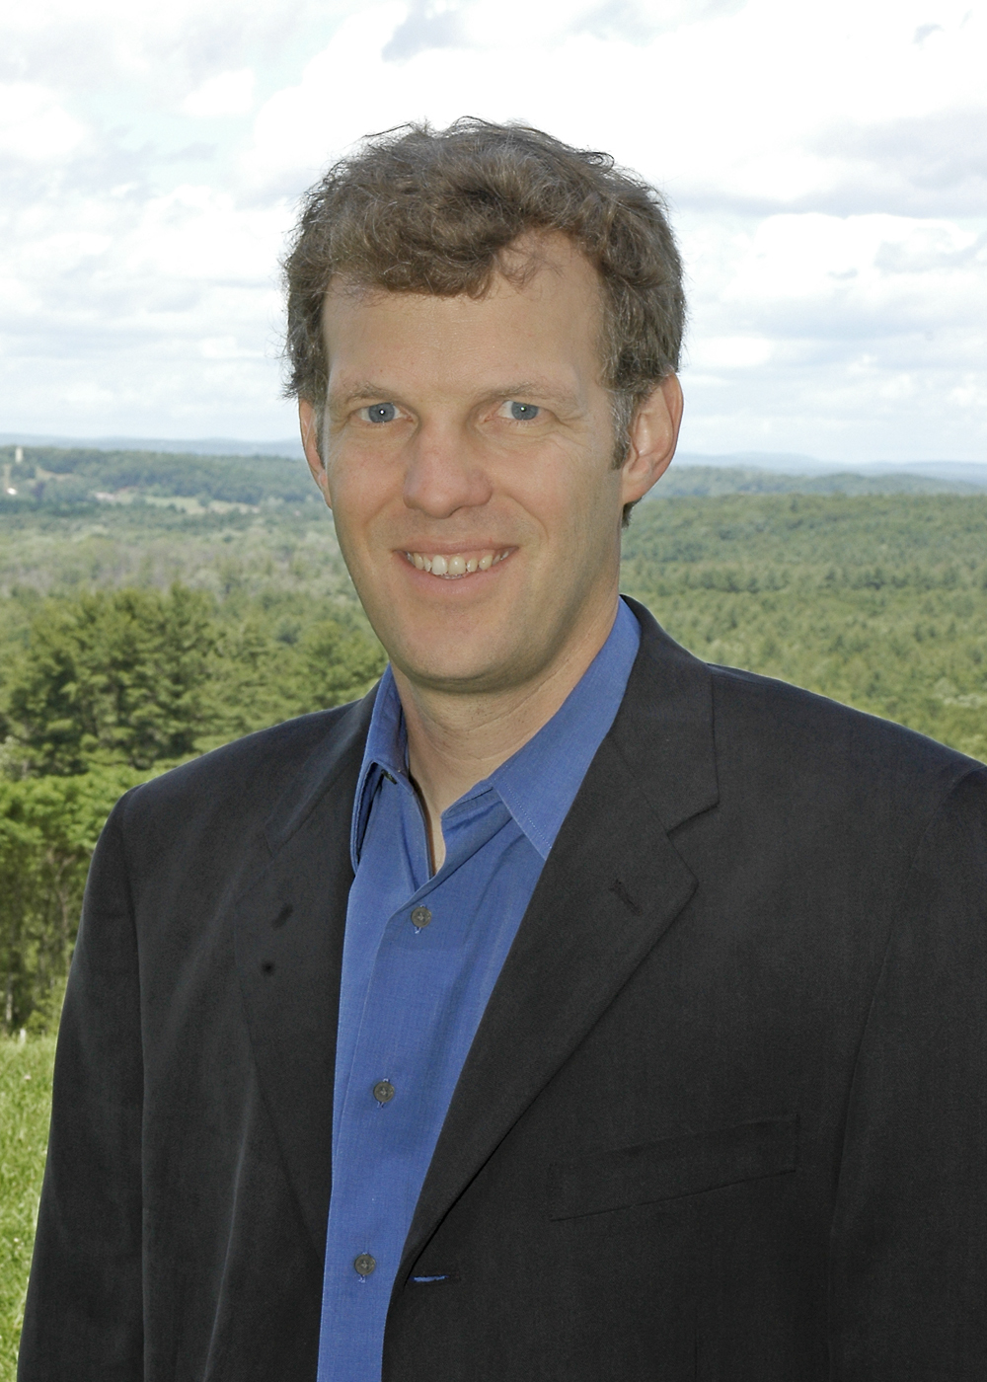
Built upon previous work by
Built upon previous work by our team
John Sterman
PhD Thesis, MIT, 1982
  The energy transition and the economy : a system dynamics approach
Professor and Director of System Dynamics Group, MIT Sloan
Tom Fiddaman
PhD Thesis, MIT, 1997
  Feedback complexity in integrated climate-economy models
Ventana Systems

Slide 6
Framing

Slide 7
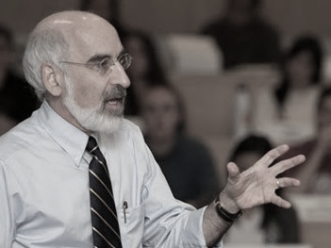
“Research shows that showing people research doesn’t work.”
- Prof. John Sterman,
MIT Sloan

Slide 8

Reactive &
Responsive
Events
Adaptive &
Proactive
Patterns of Behavior
Systemic Structure
& Mindsets
Creative &
Transformative
Notes:
And we can be creative and transformative when we address the systemic structure and mindsets.
We create a fundamentally different future by changing things at the root cause level. Mitigation work, reducing ghg emissions. And doing it in deep ways. Different rules, incentives, mindsets, beliefs, information flows…..

Slide 9
En-ROADS Structure

Slide 10
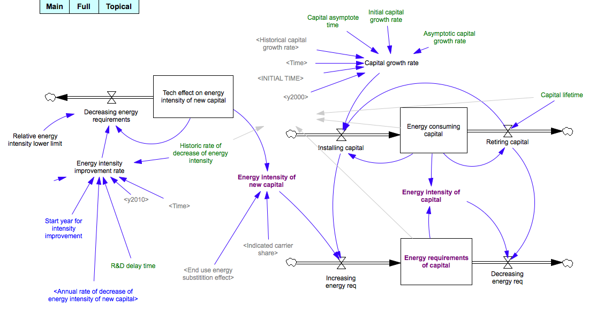

Slide 11
En-ROADS Simulation Structure
GHGS from
• Other gasses
• land use
Energy Demand
Energy intensity
Stationary & mobile
Elec & Non-elec
Aging, efficiency, & retrofits
Climate impacts
Total emissions
Concentrations
Cumulative Emissions
Temperature Change
Sea level rise
Economy
GDP
CO2 Emissions from Energy Production
Energy Supply
Carbon intensity
8 types
Aging delays
R&D success
Prices, learning, complementary assets, resources available
Other impacts
Materials
Units built
Energy poverty
Policy/R&D
Carbon price
Subsidies
Technical Breakthrough

Slide 12
The reinforcing learning process for renewable energy
Relative attractiveness of renewables
Relative price of renewables
Percent of new capacity met by renewables
R1 - Learning
Installations of renewables
Progress down learning curve
Notes:
R1 with new tech

Slide 13
Renewables don’t get the chance to build up complementary infrastructure
Relative attractiveness of renewables
Percent of new capacity met by renewables
Complementary infrastructure and resources
R2 - Network
Installations of renewables
Notes:
R1 r2 more loop

Slide 14
Both reinforcing loops together
Relative attractiveness of renewables
Relative price of renewables
R1 - Learning
Percent of new capacity met by renewables
Complementary infrastructure and resources
R2 - Network
Installations of renewables
Progress down learning curve
Notes:
R1 r2 more loop

Slide 18
New Technology Scale-up Takes Time
R&D success year
Commercialization time (12 years)
Achieving prototype
Becoming ready
New Tech in R&D Prototype
New Tech in Commercial-ready
Ordering capacity
Development time (2 years)
Construction time (5 years)
New Tech Capacity in Development
Permitting
New Tech Capacity in Construction
Constructing
New Tech Capacity in Use
(Less)
Fossil Fuel Capacity in Use
Constructing
Retiring
Average lifetime (30 years)

Slide 19
Impacts
Temperature
Total greenhouse gases (GHGs)
Energy CO₂ emissions
Land use CO₂ emissions
CO₂ removal
Other greenhouse gases (N₂O, methane,
F-gases)
Population
Consumption
Energy intensity
Carbon intensity

Slide 20
En-ROADS and C-ROADS Scope
En-ROADS
System of Energy/Economics/Climate
Technology
and Policies
GHG emissions
by regions
C-ROADS
GHG emissions
GHG cycles
Climate
Temp
Impacts
(pH, SLR)
Energy Demand, Supply, and Prices
Other forcings
CO₂
emissions
Population and GDP/capita
Other GHG emissions
Land use

Slide 21
En-ROADS, though aggregate, captures realistic energy/economy dynamics
Separate pricing of 4 fuel types (extracted/spot, delivered) and electricity
Short-term and long-term consumer responses to price: curtailment, rebound, energy efficiency, choice of fuels and electricity
Extracted fuel prices fluctuate via endogenous commodity cycle
Delivered fuel prices affected by extracted prices, but more stable
Electricity source decisions based largely on cost comparison, but also network complementarities and performance standards
Learning curves reduce energy production costs
Time delays (and possible “overheating”) in building new supply capacity
Fossil fuel production costs increased by resource depletion
Other production costs (biofuel, hydro, renewables) potentially increased by flow limits
Notes:
1. Multi-tier pricing: 4 extraction (spot/crude) fuel prices, 4 delivered fuel prices, 1 electricity price.
2. Short-term and long-term consumer responses to price: curtailment, rebound, improving energy efficiency of capital (new as well as existing through retrofits), changing fuel sources, and choice of electric vs. non-electric channel for stationary and mobile uses. Choice of electric channel for mobile uses also affected by complementary network growth.
3. Fuel extraction sector is largely unplanned/decentralized and prone to commodity-cycle fluctuation, with capacity adjustments based on profitability and price adjustments based on capacity utilization.
4. Production of delivered fuels and electricity sectors are largely planned with respect to capacity expansion, but capacity utilization fluctuates with price/profitability, and profitability is impacted by extracted fuel price fluctuations.
5. Electricity sector chooses among alternative energy sources based on their costs, but also affected by network complementarities and performance standards.
6. Production costs for a particular energy source decline through learning, as a result of cumulative production and cumulative R&D; some fraction of revenue is invested in R&D for each energy source.
7. Construction of new supply capacity takes time, and may be temporarily constrained due to rapid growth, leading to a bidding up of construction costs (“overheating effect”).
8. Resource depletion (oil, coal, gas) and pushing against flow limits (biofuels, hydro, renewables) drives up production costs.

Slide 22
En-ROADS Slider Settings

Slide 23
Renewables

Slide 24
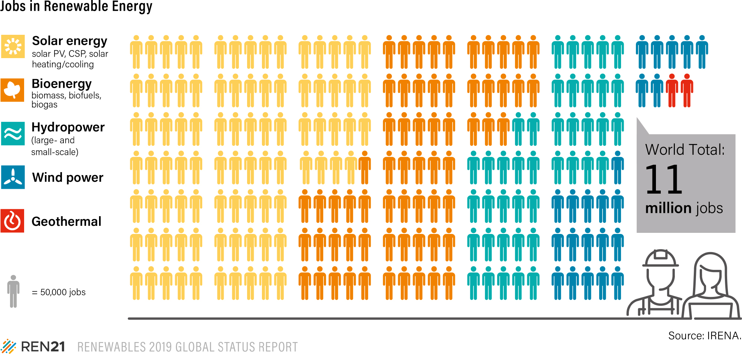
Notes:
Source: https://www.ren21.net/reports/global-status-report/

Slide 25
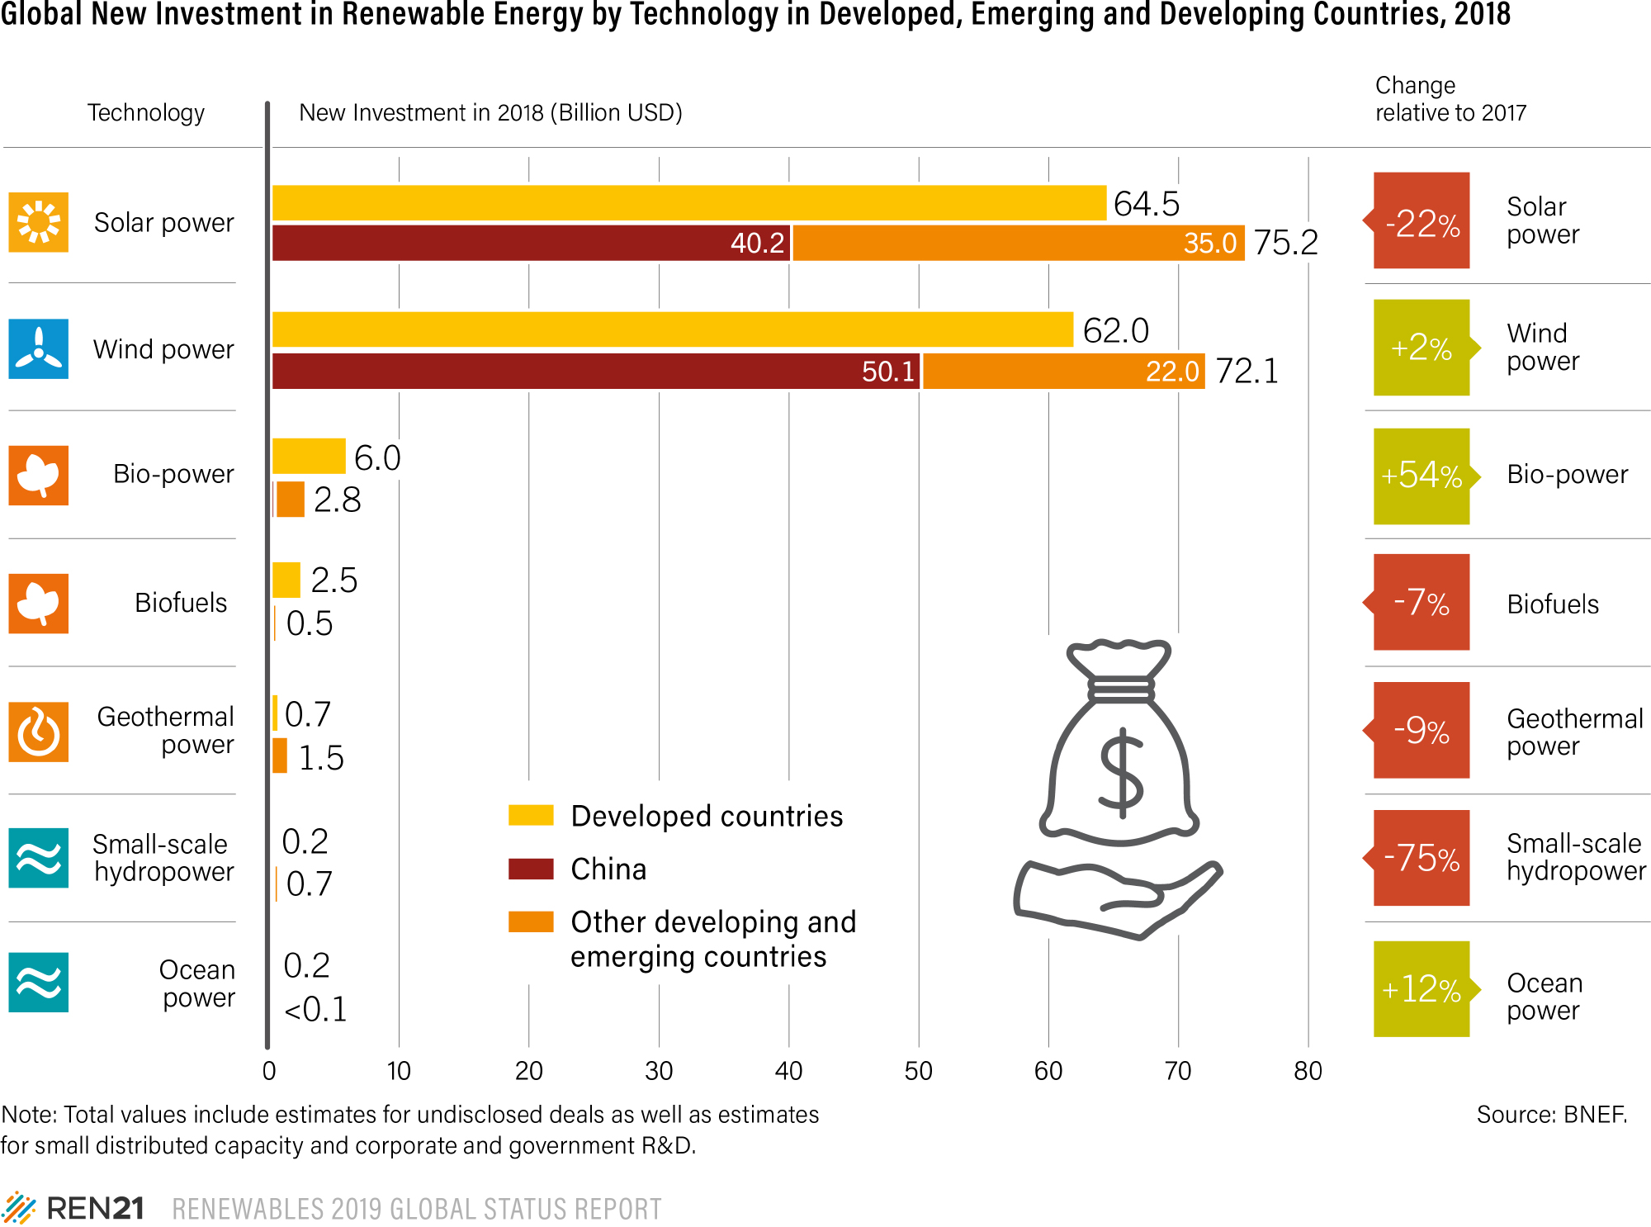
Notes:
Source: https://www.ren21.net/reports/global-status-report/

Slide 26
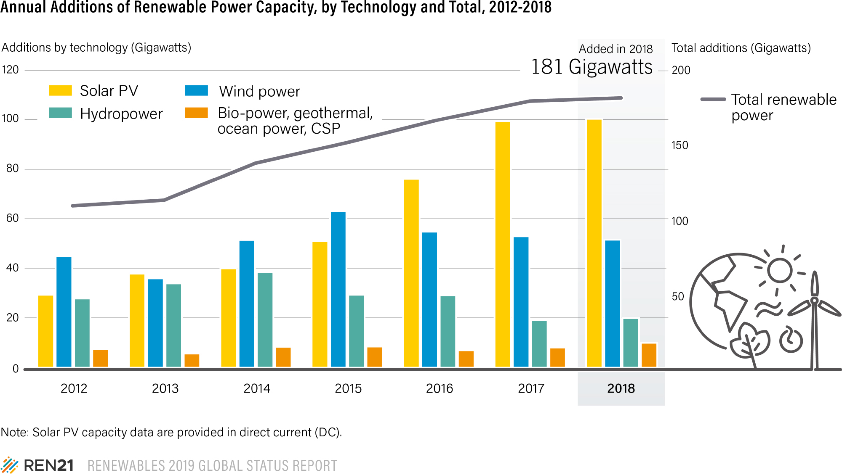
Notes:
Source: https://www.ren21.net/reports/global-status-report/

Slide 27
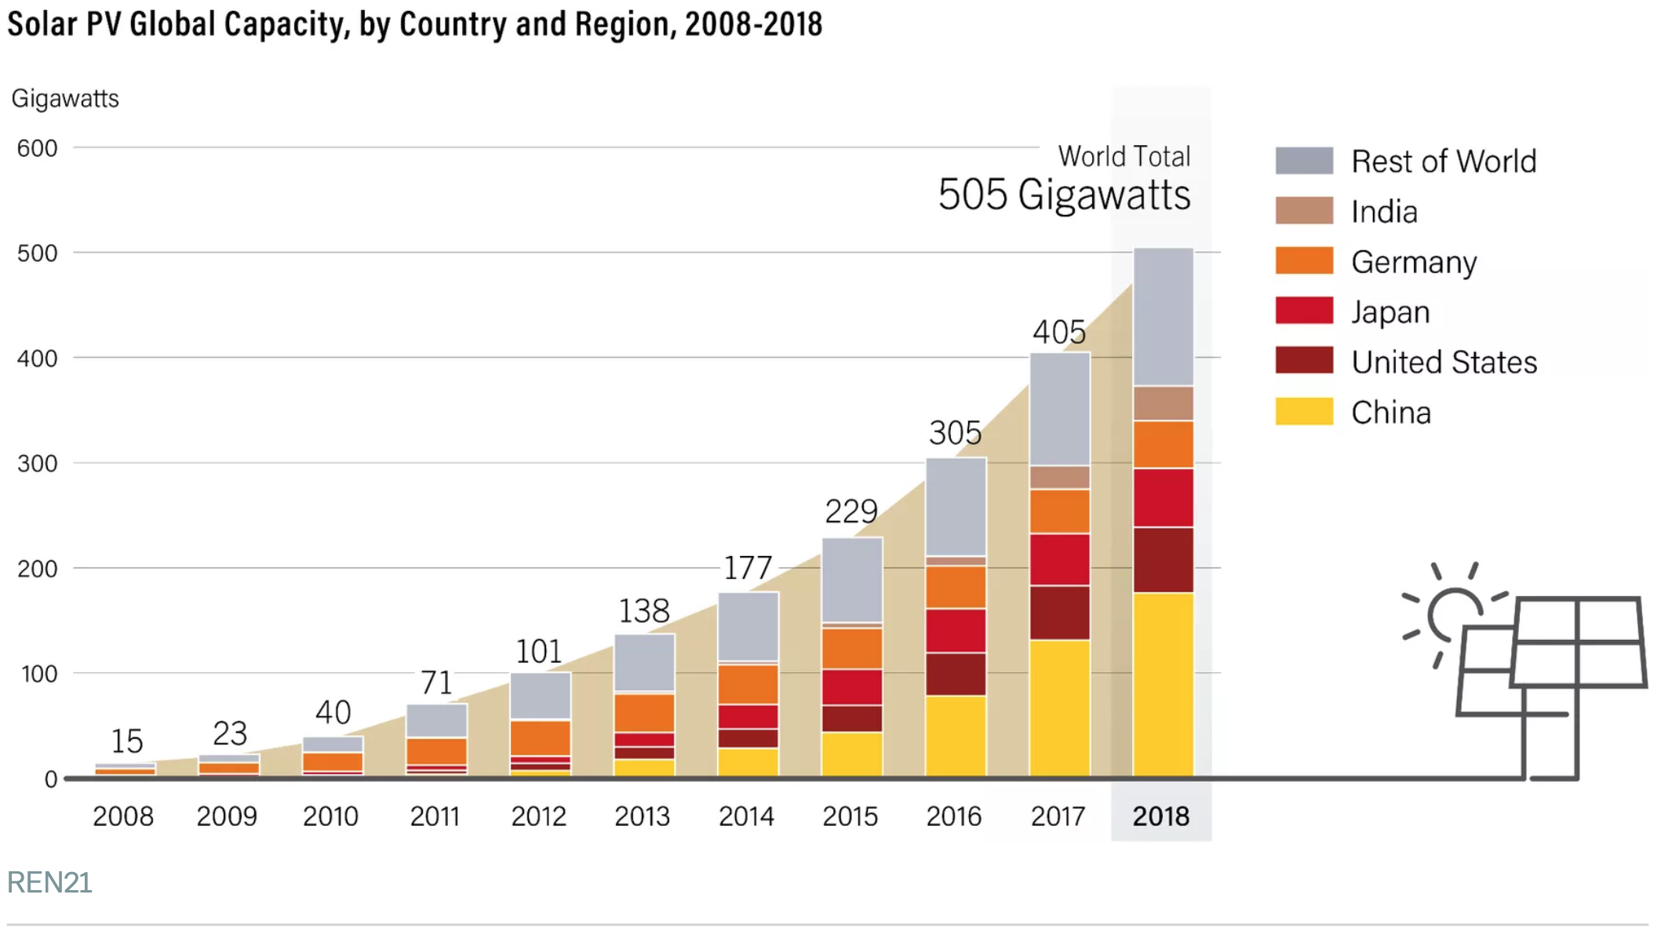
Notes:
Source: https://www.vox.com/energy-and-environment/2019/6/18/18681591/renewable-energy-china-solar-pv-jobs

Slide 28
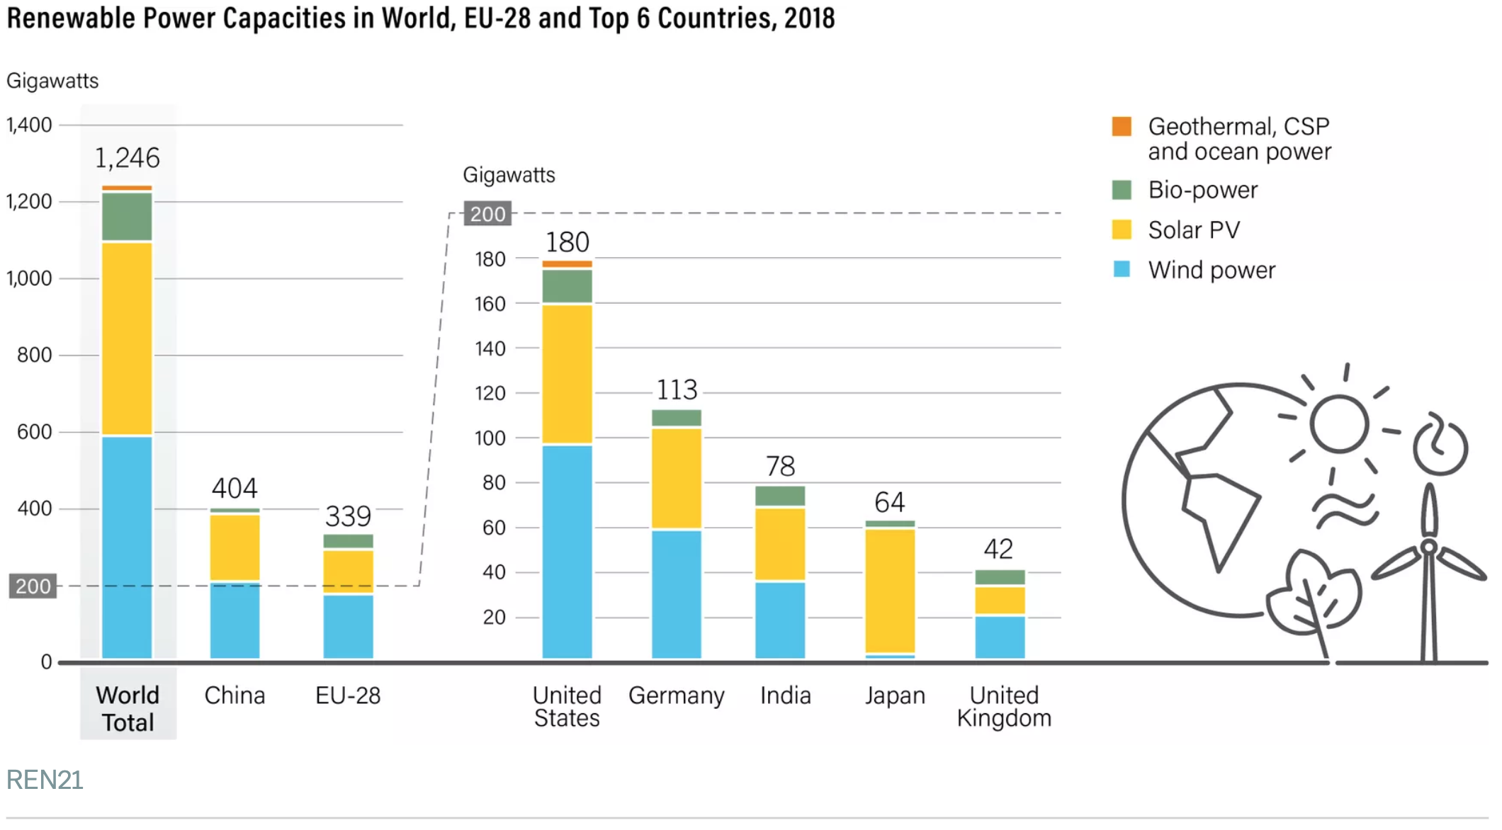
Notes:
Source: https://www.vox.com/energy-and-environment/2019/6/18/18681591/renewable-energy-china-solar-pv-jobs

Slide 29
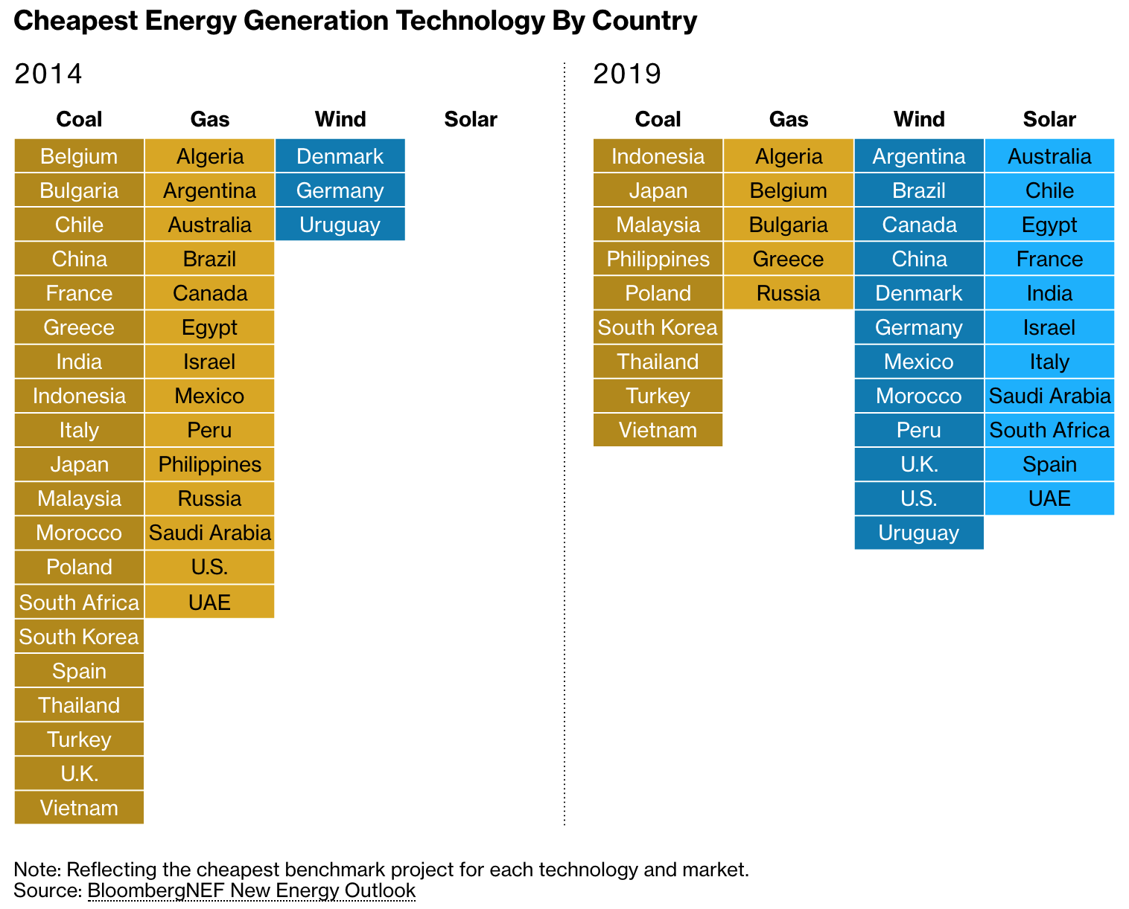
Notes:
Source: https://www.bloomberg.com/graphics/2019-can-renewable-energy-power-the-world/

Slide 30
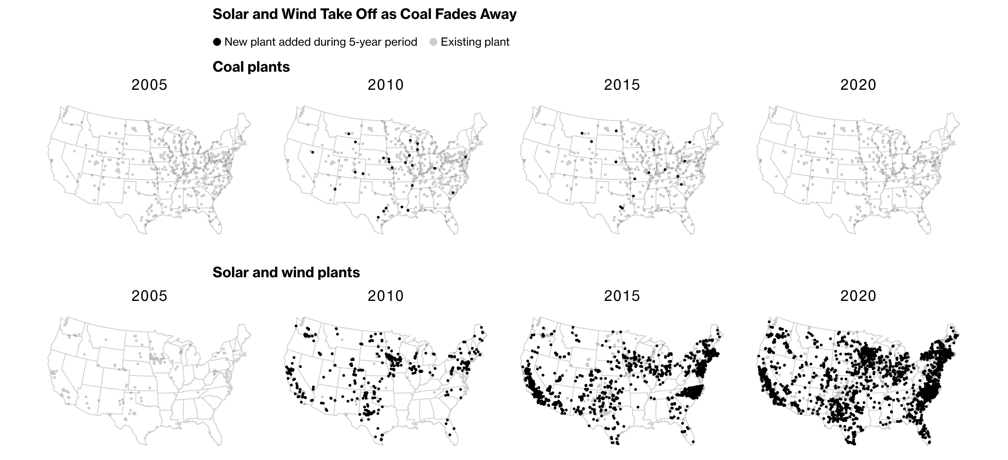
Notes:
Source: https://www.bloomberg.com/graphics/2019-can-renewable-energy-power-the-world/

Slide 31
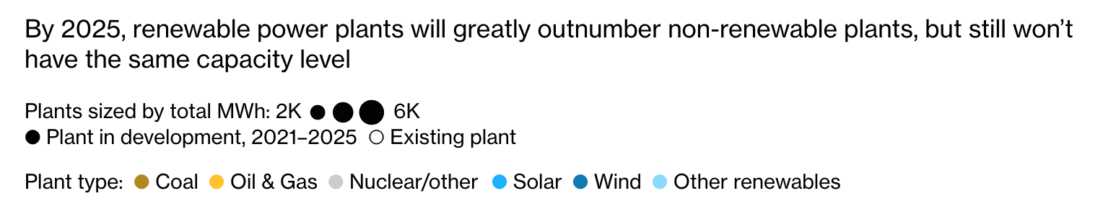
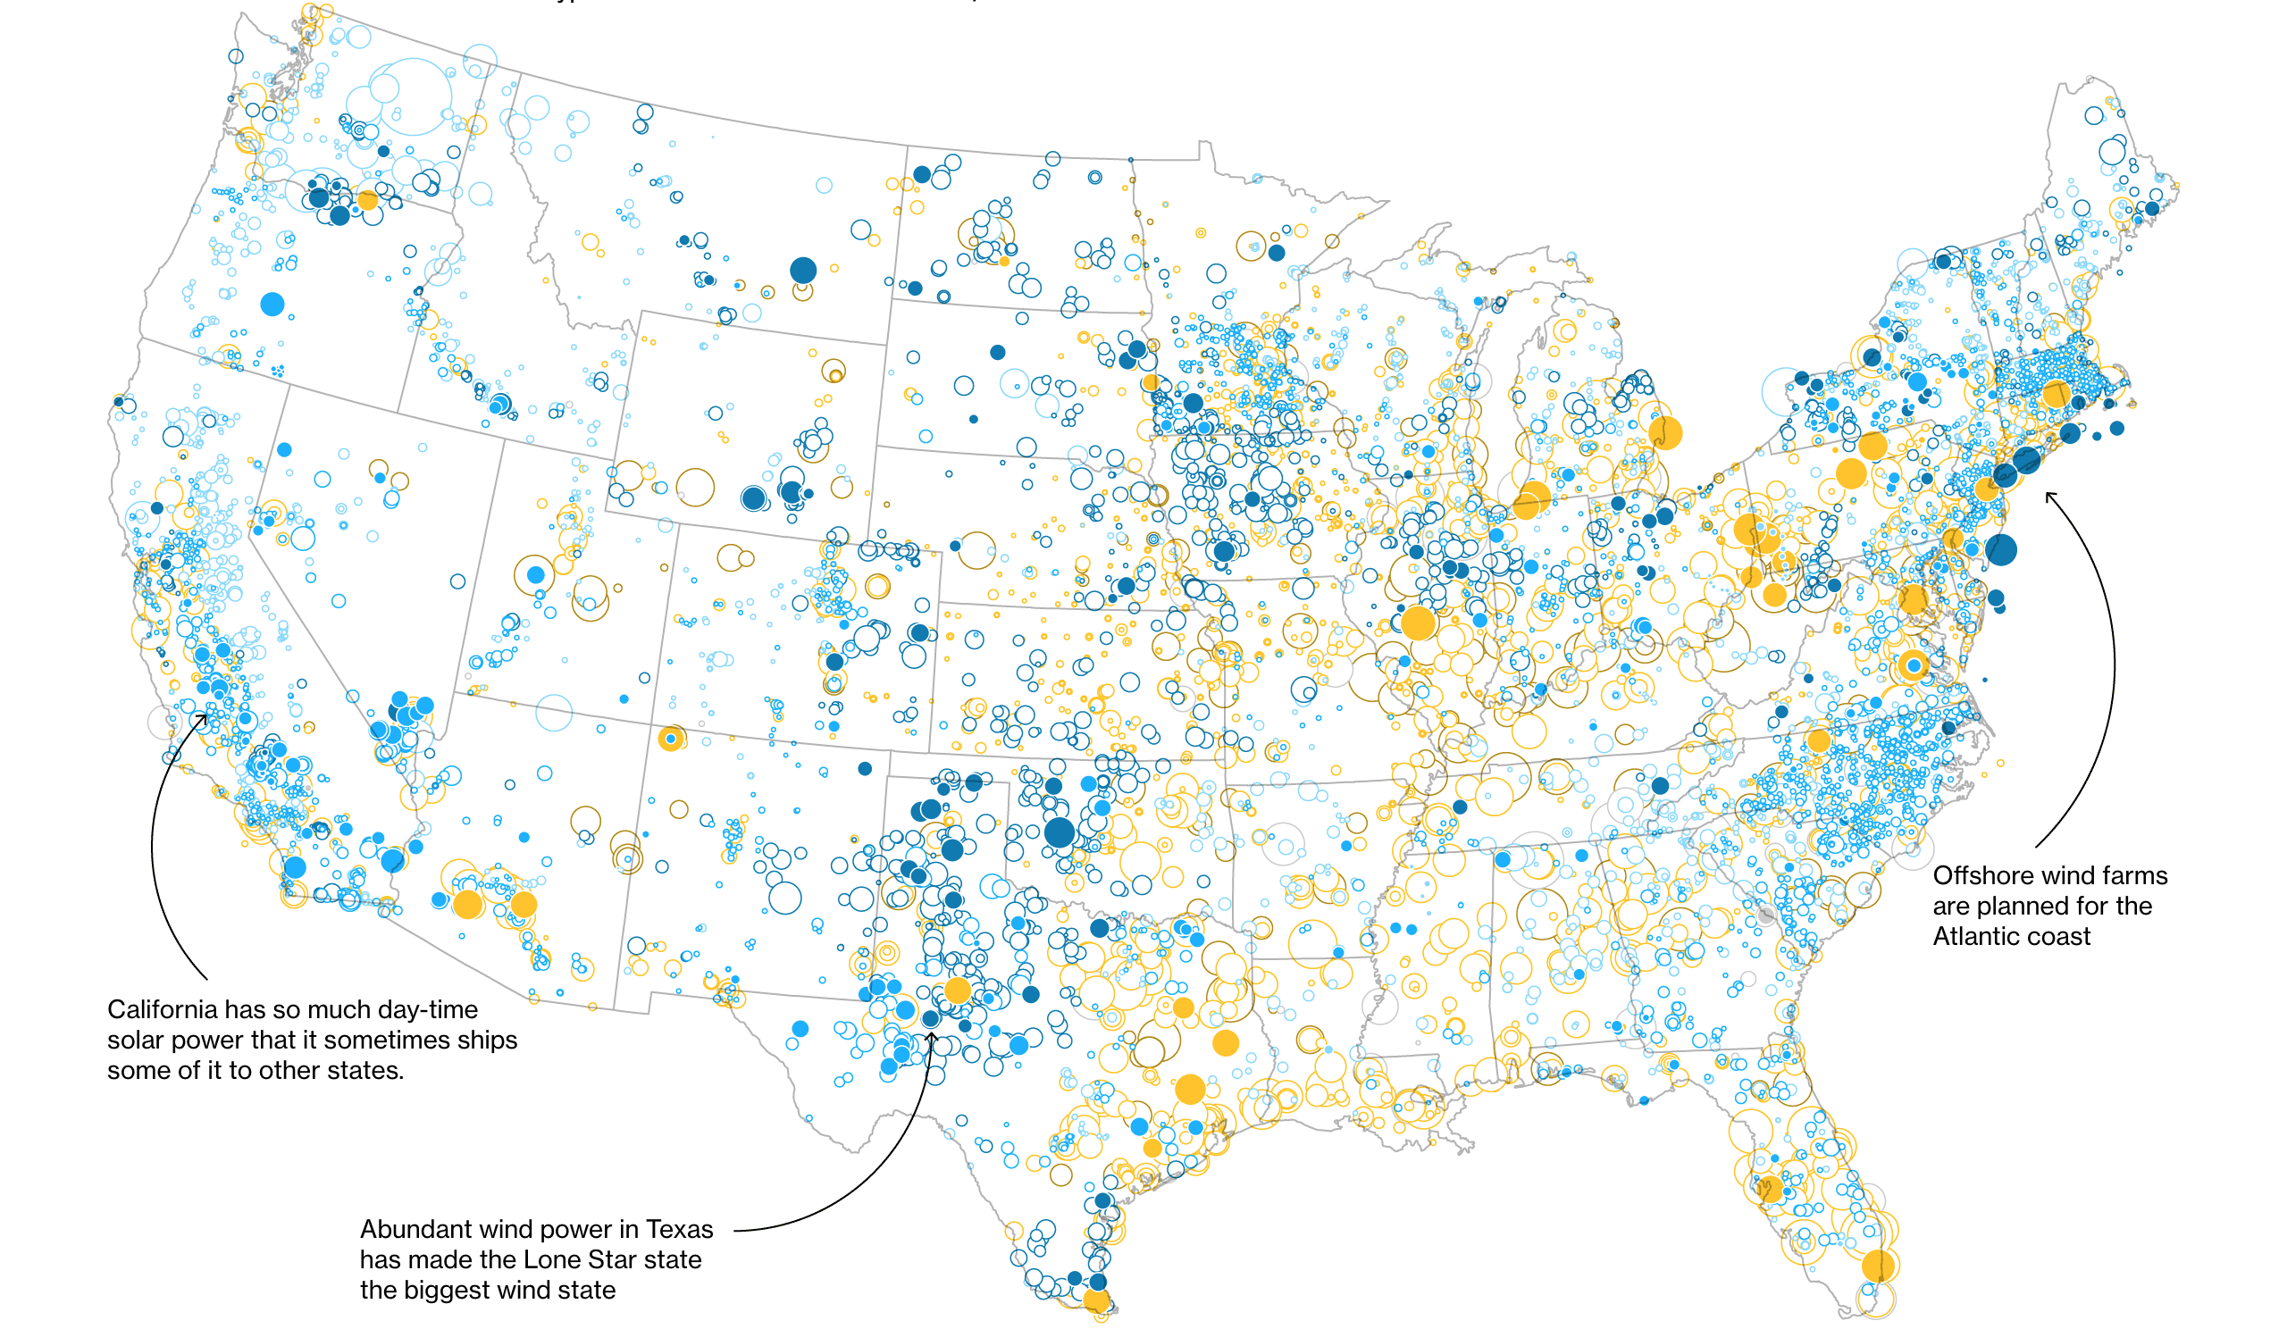
Notes:
Source: https://www.bloomberg.com/graphics/2019-can-renewable-energy-power-the-world/

Slide 32
Over the Tipping Point
Carbon Tax,
Emissions Cap
+
Government
Subsidies
Price of
Fossil Fuels
+
–

Slide 33
Coal, Oil, Natural Gas

Slide 34
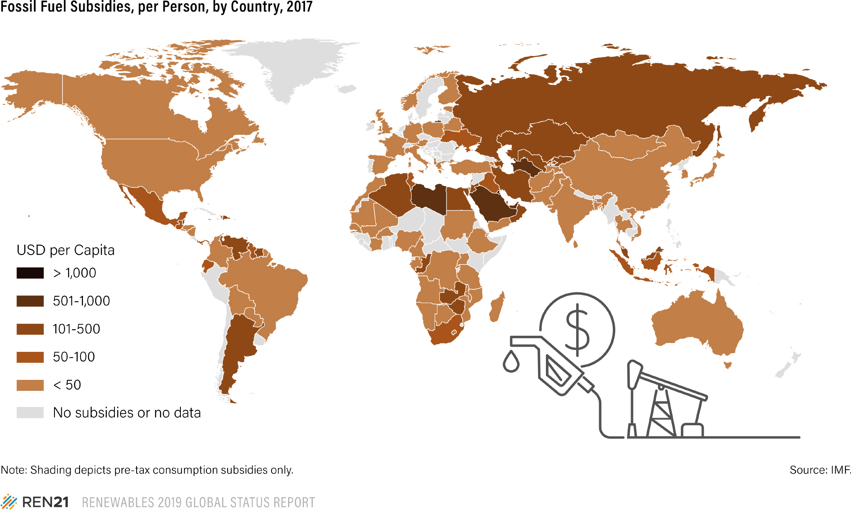
Notes:
Source: https://www.ren21.net/reports/global-status-report/

Slide 35
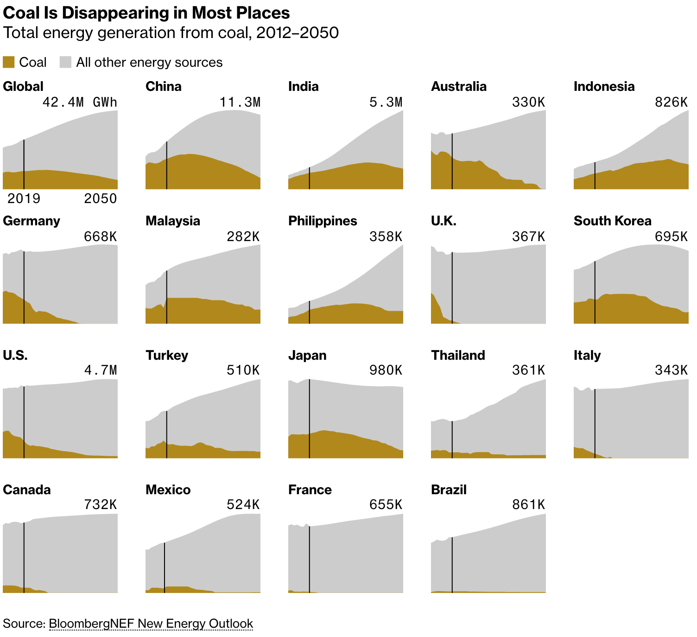
Notes:
Source: https://www.bloomberg.com/graphics/2019-can-renewable-energy-power-the-world/

Slide 36
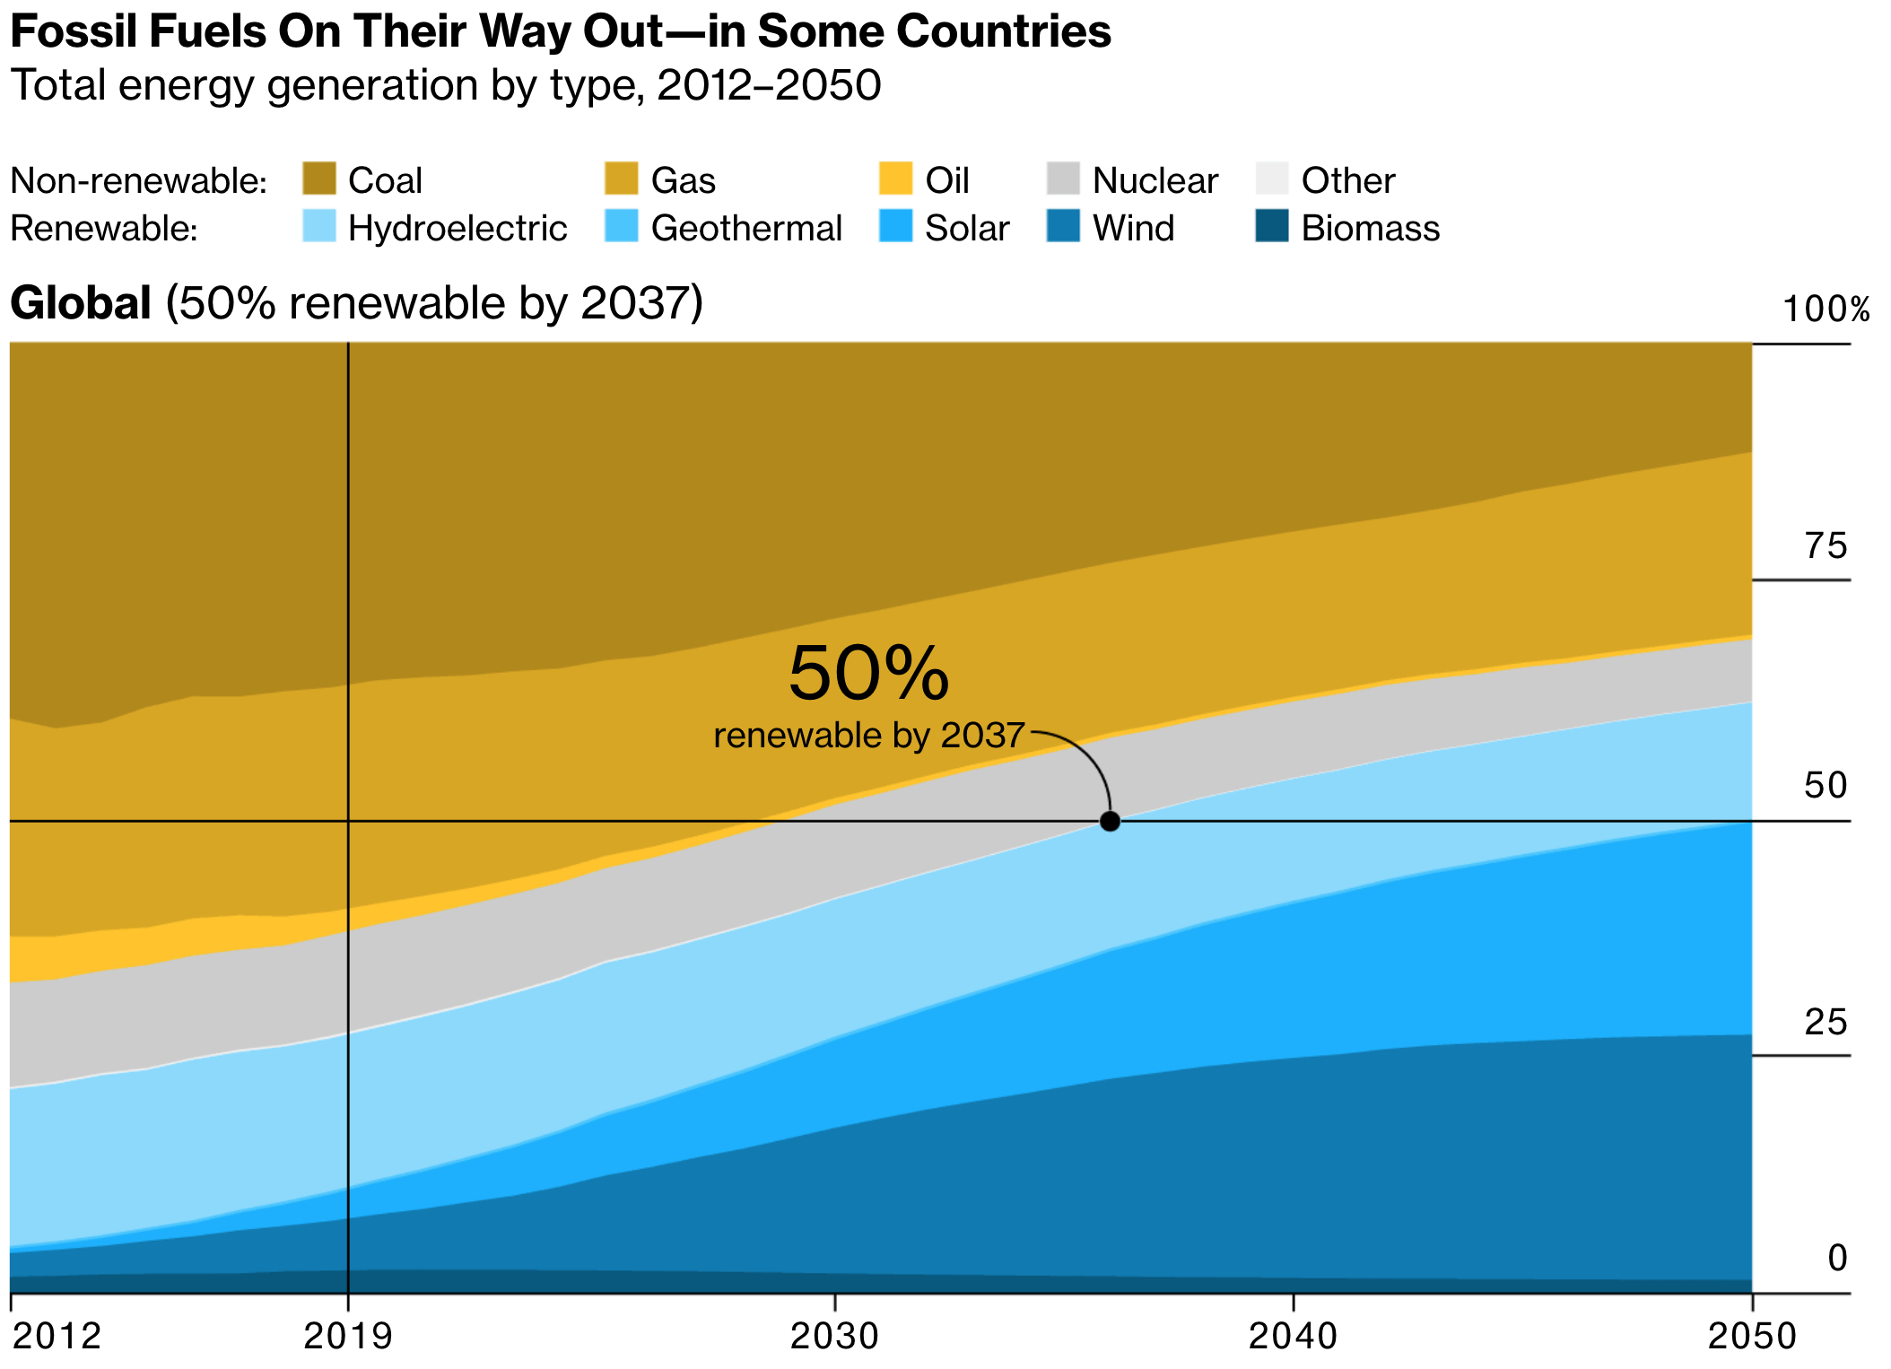
Notes:
Source: https://www.bloomberg.com/graphics/2019-can-renewable-energy-power-the-world/

Slide 37
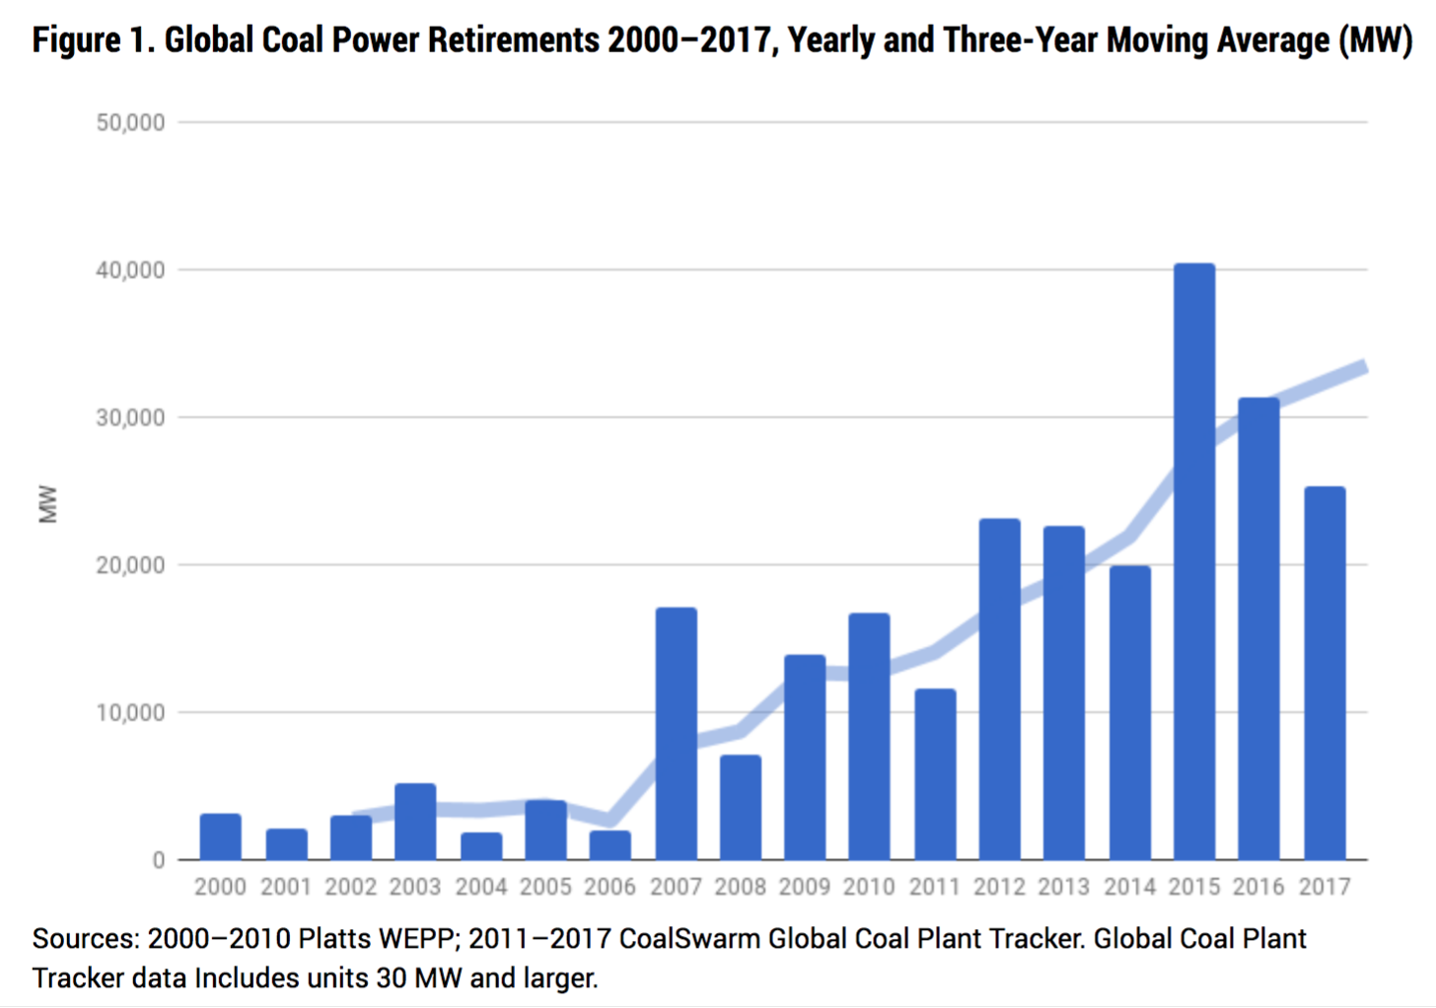
Global Coal Power Retirements 2000-2017 (MW)
In the last decade about 1% of existing coal power has been retired each year.
However, there are still more new plants built each year than are being retired.
Notes:
Source: https://endcoal.org/wp-content/uploads/2018/03/BoomAndBust_2018_r6.pdf

Slide 38
Carbon Price

Slide 39
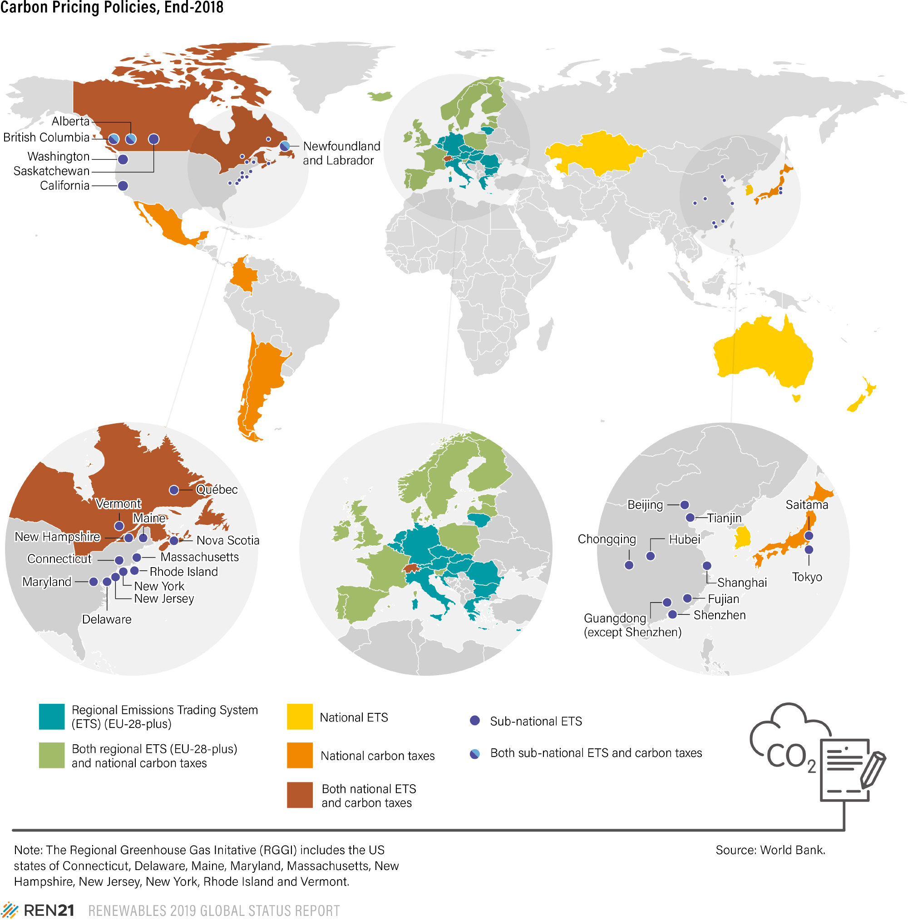
Notes:
Source: https://www.ren21.net/reports/global-status-report/

Slide 40
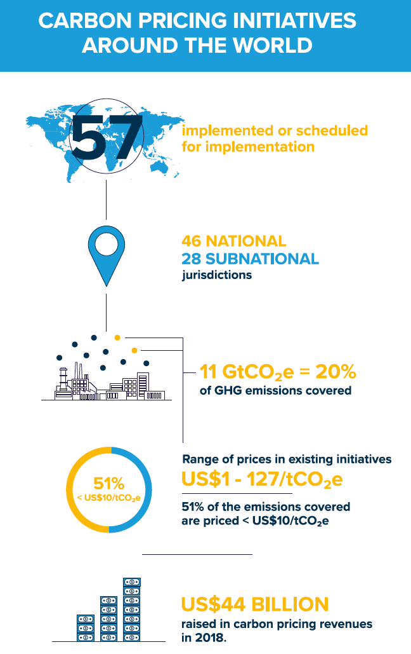
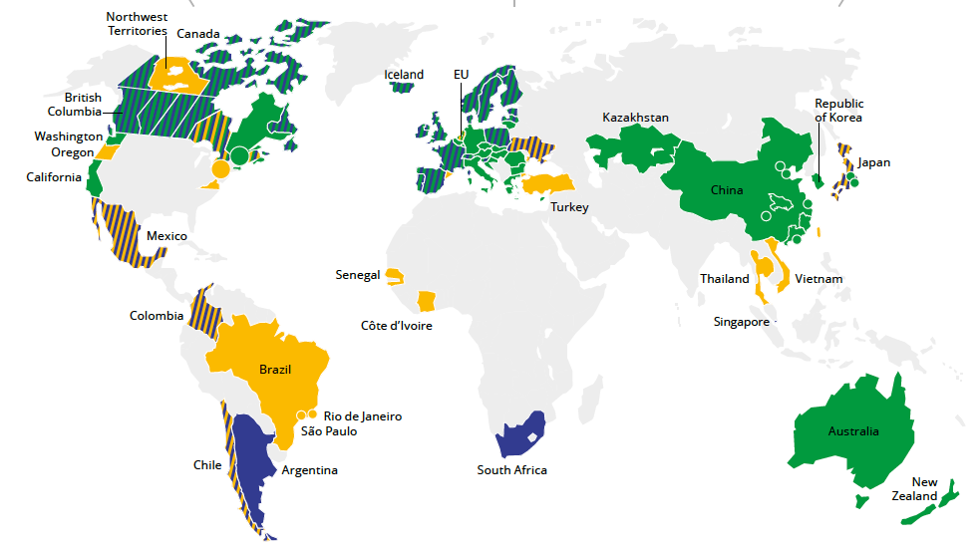
Carbon prices are being
enacted around the world
Notes:
Source: https://carbonpricingdashboard.worldbank.org/map_data

Slide 41
Energy Efficiency

Slide 42
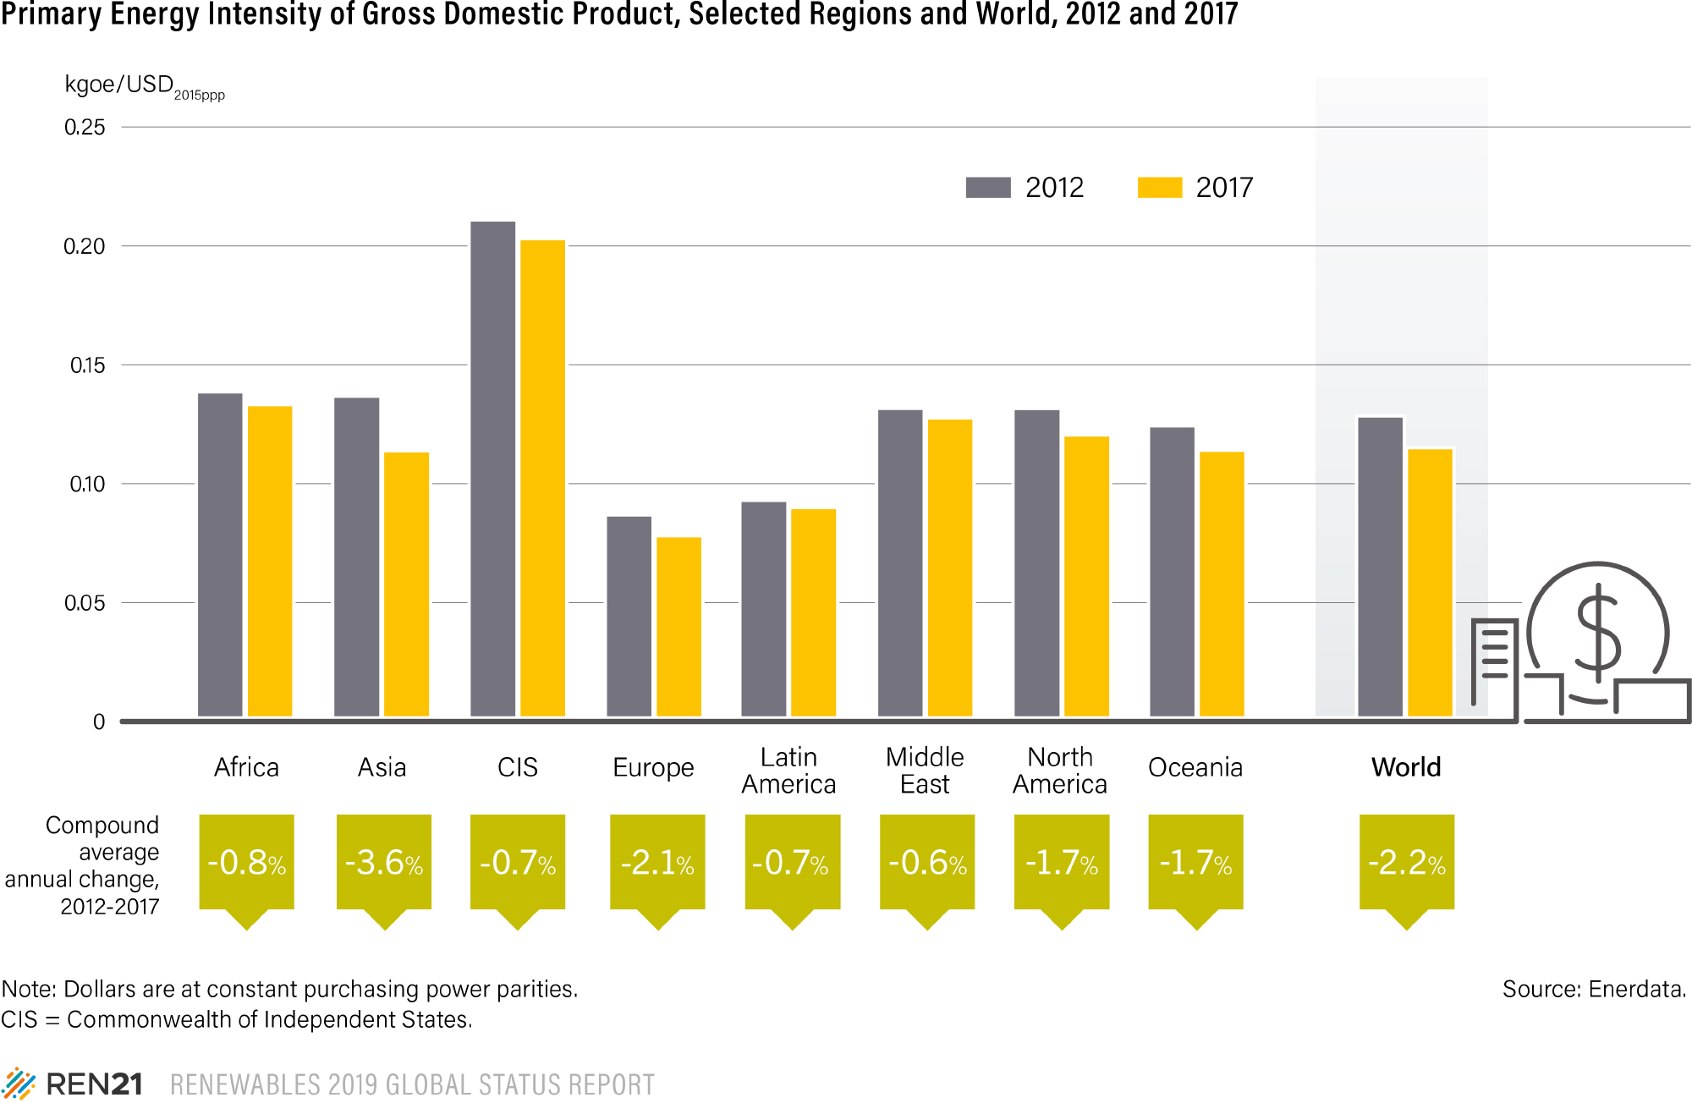
Notes:
Source: https://www.ren21.net/reports/global-status-report/

Slide 43
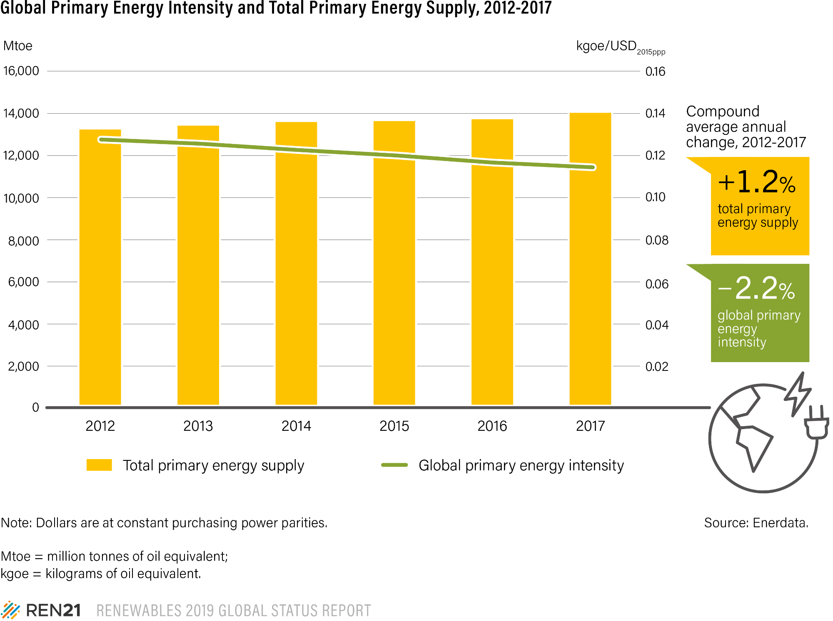
Notes:
Source: https://www.ren21.net/reports/global-status-report/

Slide 44
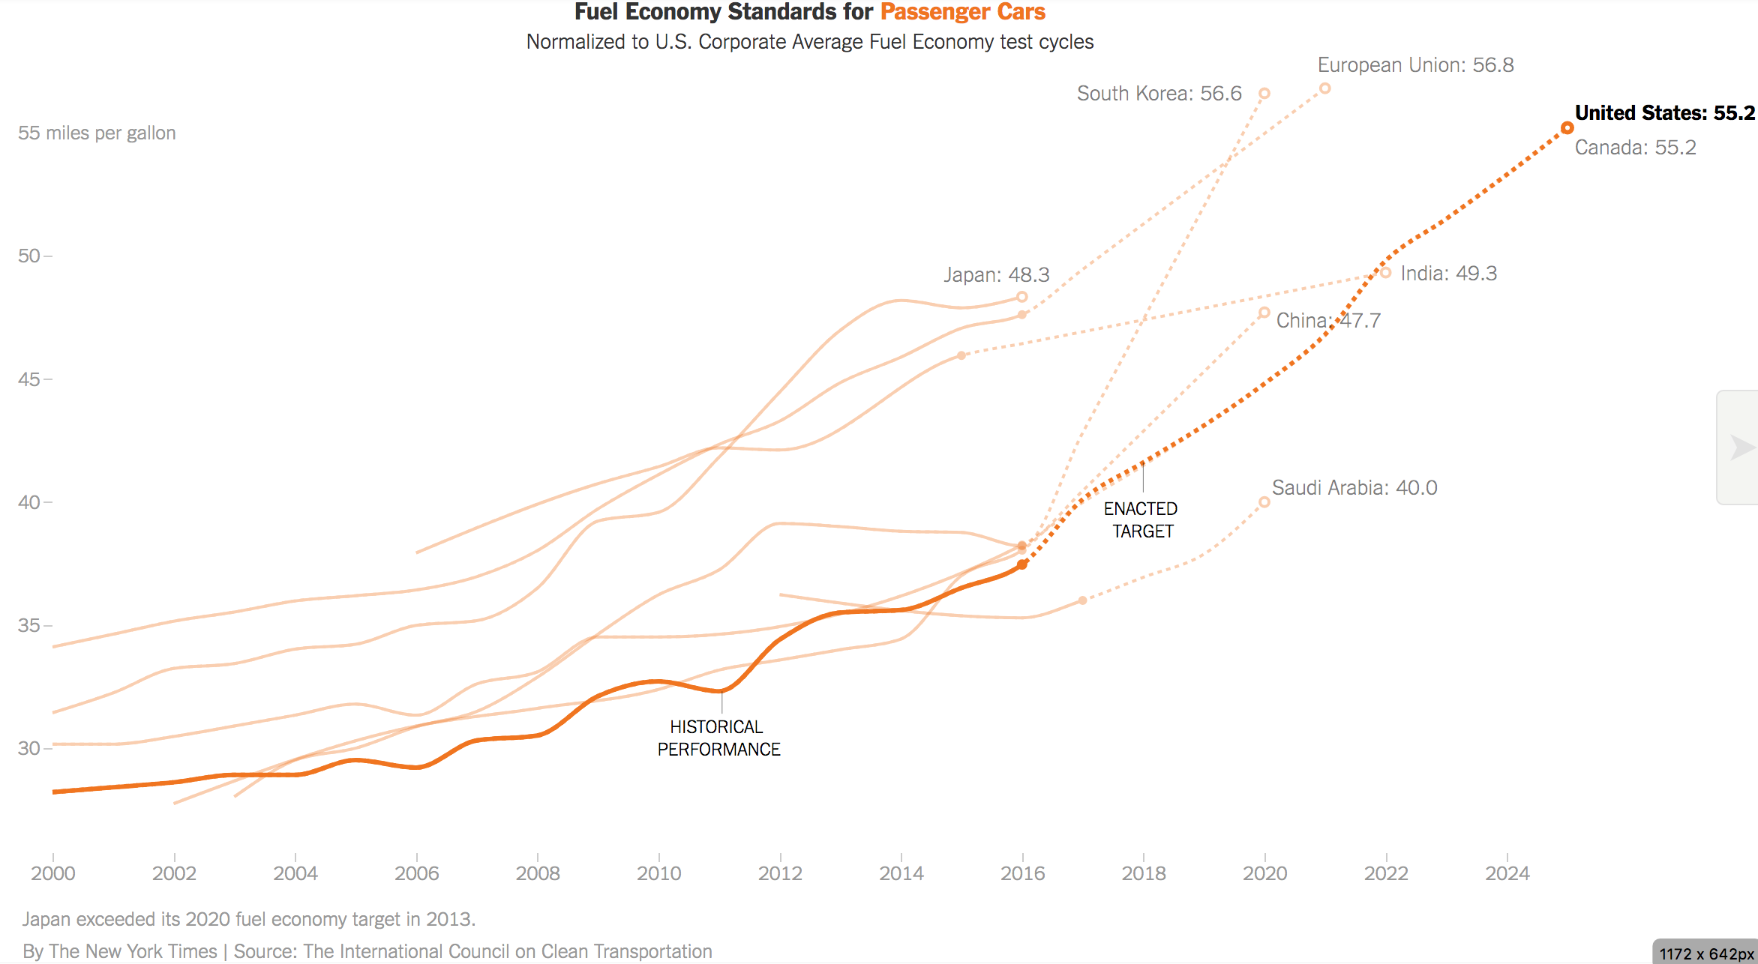
Notes:
Source: https://www.nytimes.com/interactive/2018/04/03/climate/us-fuel-economy.html?em_pos=small&emc=edit_clim_20180404&nl=&nl_art=2&nlid=66315536c%3Dedit_clim_20180404&ref=headline&te=1

Slide 45
Electrification

Slide 46
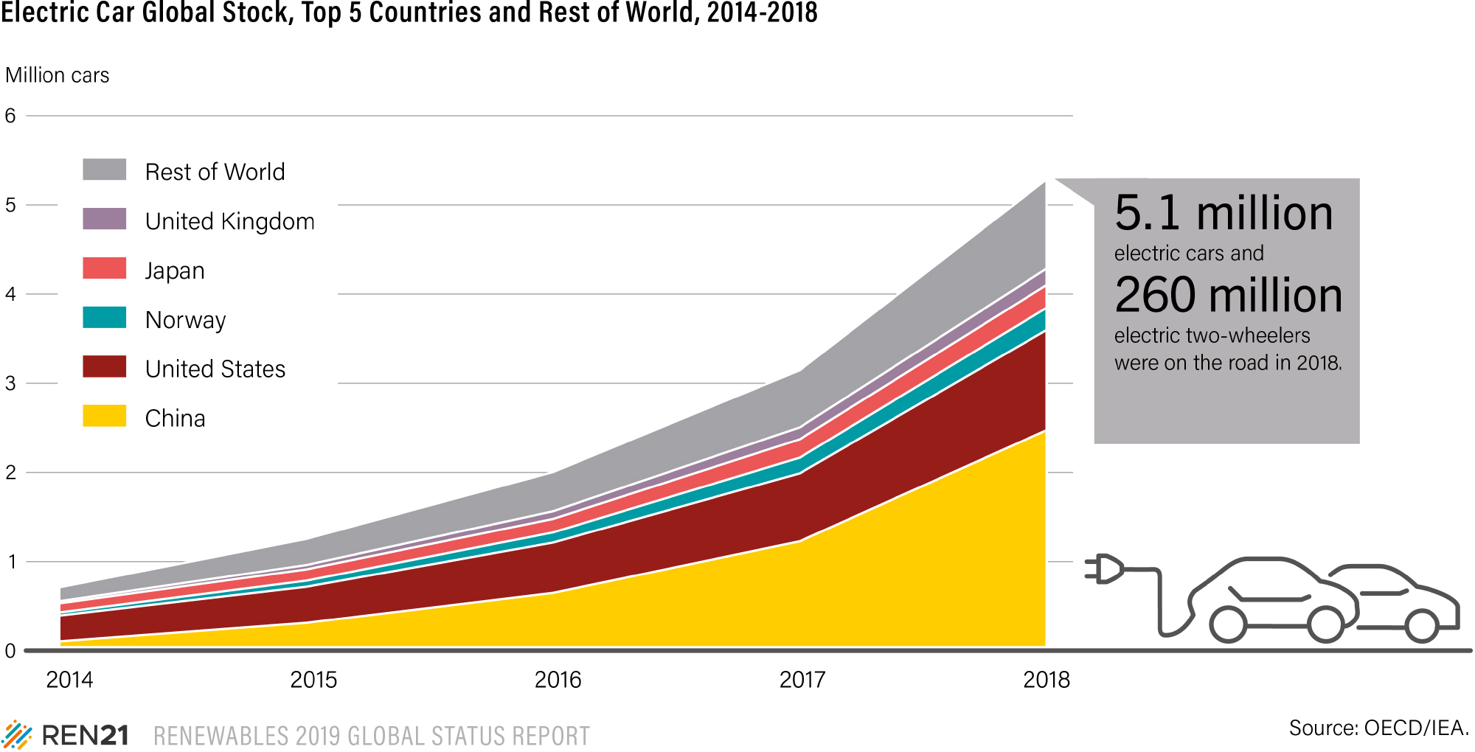
Notes:
Source: https://www.ren21.net/reports/global-status-report/

Slide 47
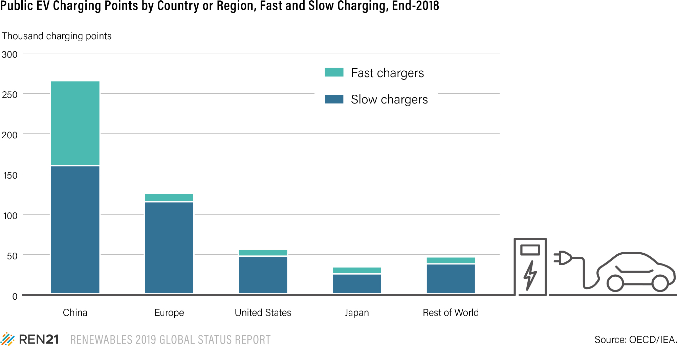
Notes:
Source: https://www.ren21.net/reports/global-status-report/

Slide 48
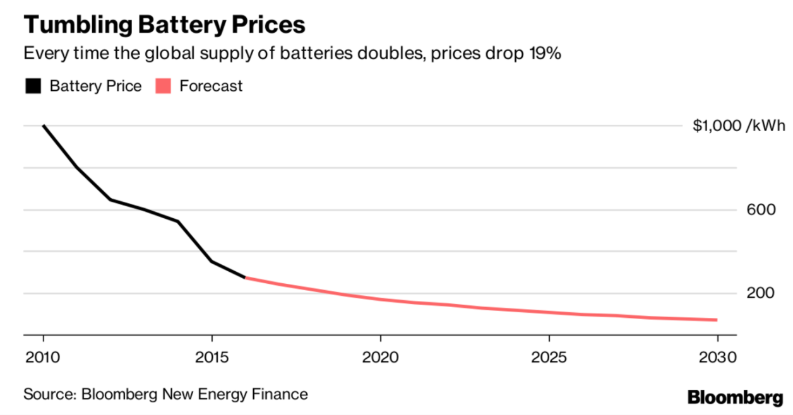
Notes:
https://www.bloomberg.com/news/articles/2017-11-30/musk-s-battery-boast-will-be-short-lived-as-rivals-go-bigger

Slide 49
Population &
Economic Growth

Slide 50
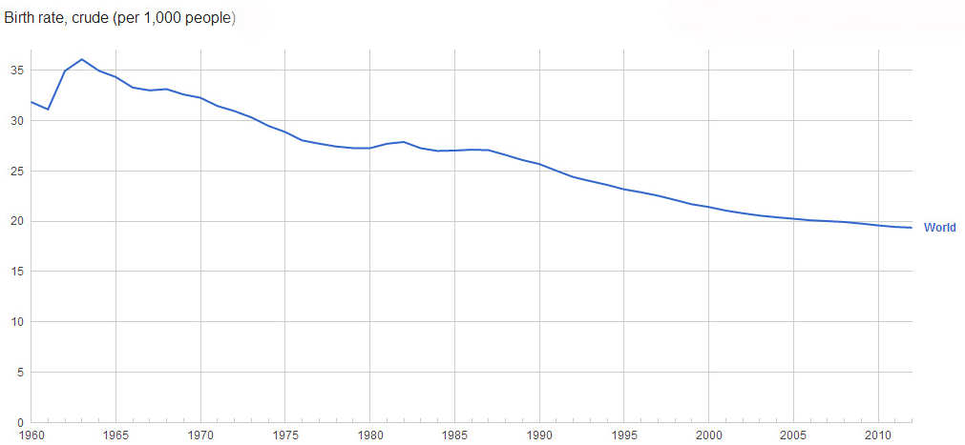
World birth rates have decreased from a high of 36.1 in 1963, down to 19.4 by 2012.
Birth rate, crude (per 1000 people)
35
30
25
20
15
10
5
0
1960
1965
1970
1975
1980
1985
1990
1995
2000
2005
2010
Notes:
Based on data from the World Bank.
Source: http://www.google.com/publicdata/explore?ds=d5bncppjof8f9_#!ctype=l&strail=false&bcs=d&nselm=h&met_y=sp_dyn_cbrt_in&scale_y=lin&ind_y=false&rdim=region&ifdim=region&tdim=true&tstart=-298054800000&tend=1342940400000&hl=en_US&dl=en_US&ind=false

Slide 51
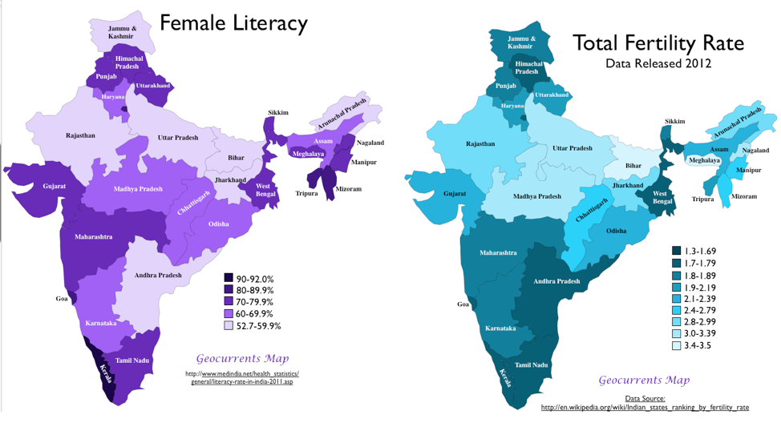
Across the globe, the education of women is often correlated to significant reductions in fertility rates.
Notes:
Source: http://www.cdc.gov/nchs/pressroom/97facts/edu2birt.htm

Slide 52
Methane &
Other Gases

Slide 53

What’s happening?
2015 Global Greenhouse Gas (GHG) Emissions
Land
Use
CO2
7%
63% of emissions come from fossil fuels, so cutting emissions from deforestation, methane, N₂O and other sources from agriculture and industry is essential to limiting warming.
Some action is being taken, but more is needed.
HFC emissions are being reduced through an amendment to the Montreal Protocol.
50 governments (incl. US, Canada, EU) are aiming to end deforestation by 2030 under the NY Declaration on Forests.
Other GHGs
30%
Energy CO2
63%
From RCP 8.5 in 2015

Slide 54

Other GHGs are 30% of Anthropogenic Global CO2e Emissions
Land
Use
CO2
7%
Other GHGs
30%
Energy CO2
63%
From RCP 8.5 in 2015

Slide 55
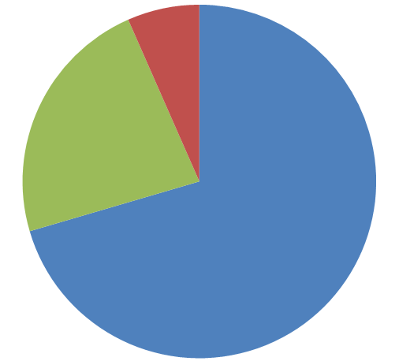
Other GHGs Breakdown by Gas
F-Gases
7%
N2O
23%
Methane
70%
From RCP 8.5 in 2015
Notes:
Methane, CH4, the main component of natural gas and product of decomposing organic matter
Nitrous Oxide, N2O, part of the nitrogen cycle, produced by bacteria in denitrification and in reactions between other nitrogen compounds
High Global Warming Potential Gasses (HiGWPs) or F-Gasses. All anthropogenic, replacements for ozone depleting substances, used in cooling systems, industrial processes, etc.

Slide 56

Other GHG Breakdown by Source
Waste
13%
Industry 9%
Agriculture
50%
Energy
28%
From EPA 2012, 2015 Estimates

Slide 57
Detail by Source - Agriculture
Manure
Burning & Other
From EPA 2012

Slide 58
Detail by Source - Energy
From EPA 2012

Slide 59
Detail by Source – Industry & Waste
From EPA 2012

Slide 60
Carbon Dioxide Removal (CDR)

Slide 61
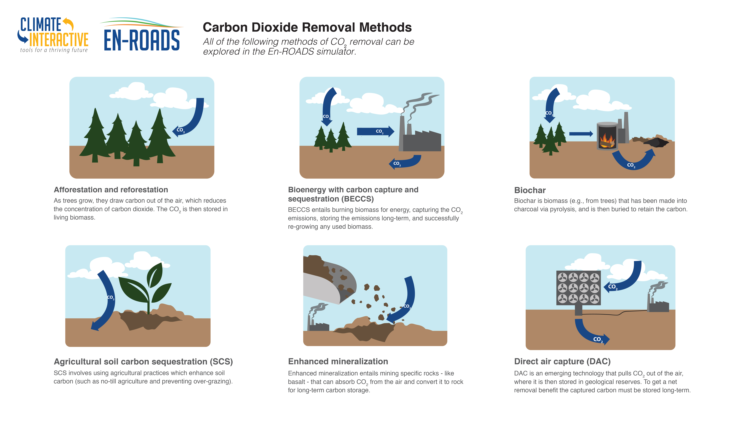


Slide 62


Slide 68
User Quotes & Press for Climate Interactive Simulations

Slide 69
“The C-ROADS model from Climate Interactive was used by me and other members of President Obama’s climate-change team for gaining rapid insights into the consequences of alternative greenhouse-gas-emissions trajectories for the United States and the rest of the world.
I used those insights in my briefings and memos for the President…, and the U.S. team used them in its interactions with experts and negotiators from other countries in the discussions leading up to the path-breaking Paris agreement in December 2015."
- John Holdren
White House Science Advisor, 2009-2017

Slide 70
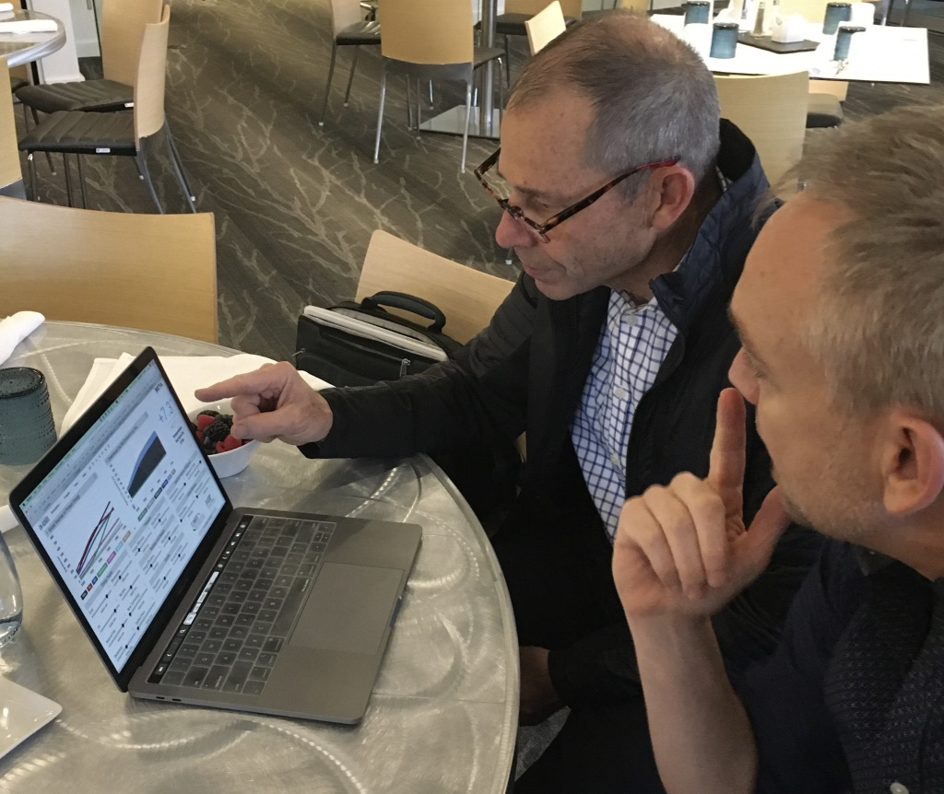
“What I like about En-ROADS is how it can support a really thoughtful conversation – I can see the ways that policy actions could be worth the pain.”
Rep. John Curtis
U.S. House of Representatives
Republican, Utah: 3rd District

Slide 71
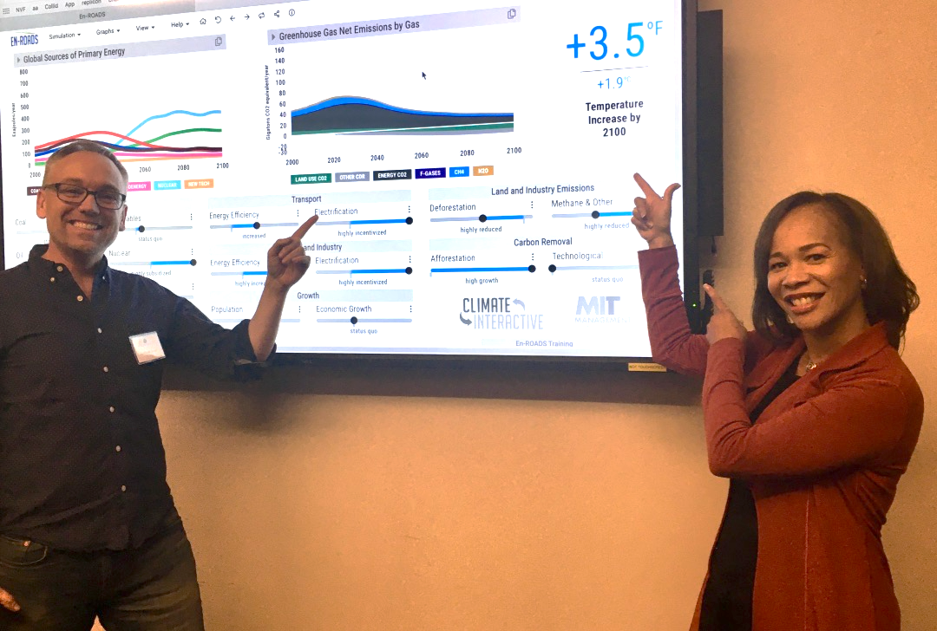
Rep. Lisa Blunt Rochester
U.S. House of Representatives
Delaware:
At-large District

Slide 72
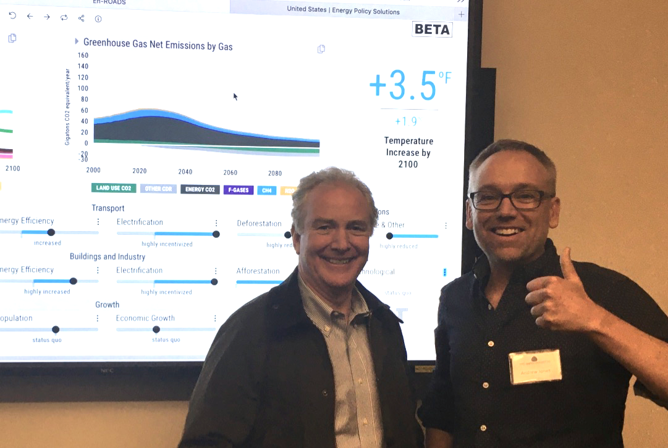
Senator Chris Van Hollen
U.S. Senate
Maryland: 8th District

Slide 73
“This MIT/CI simulator is a terrific, fantastic tool — absolutely wonderful. What I like: it is honest, shows the interesting interplay between policies, and is a bugle call about how aggressive we need to be.”
— Washington State Governor & Former Presidential Candidate
Jay Inslee

Slide 74

“En-ROADS gives me a sense of integrity as a policymaker – I can see climate results in a scientifically validated tool.”
Rep. Conor Lamb
U.S. House of Representatives
Pennsylvania: 17th District

Slide 75

“This is a game-changer for how I think about climate change policy.”
Rep. Greg Stanton
U.S. House of Representatives
Arizona: 9th District

Slide 76
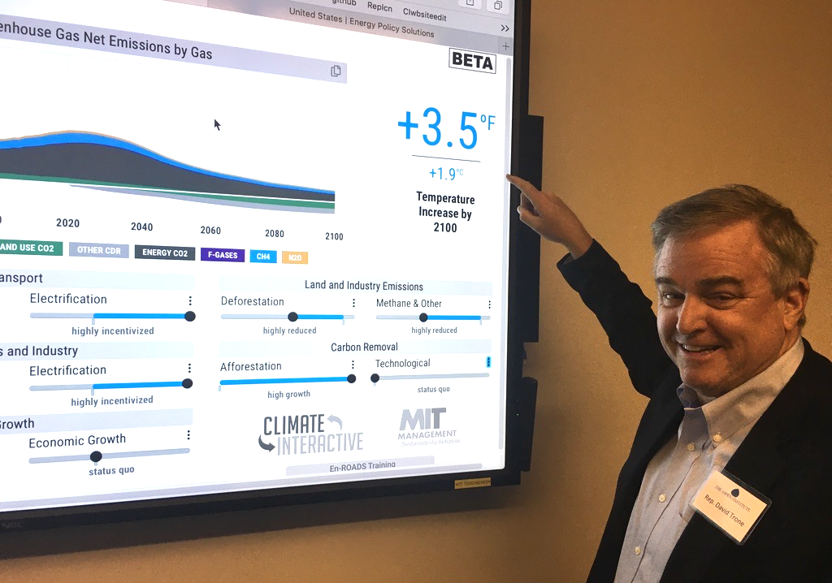
“This simulator is pretty un-friggin-believable.”
Rep. David Trone
U.S. House of Representatives
Maryland: 6th District

Slide 77
“Engaging with the En-ROADS climate simulation has been one of the best ways for me, as a policy maker, to learn about how solutions to tackle climate change can reinforce or interfere with one another.”
- Sheldon Whitehouse
US Senator
WASHINGTON DC

Slide 78
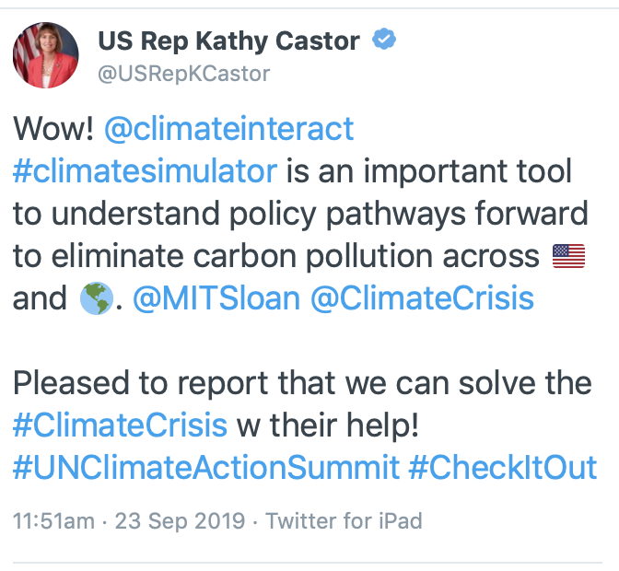


Slide 79
Multisolving

Slide 80
MULTISOLVING:
  protecting the climate while improving health, equity, and well-being

Slide 81
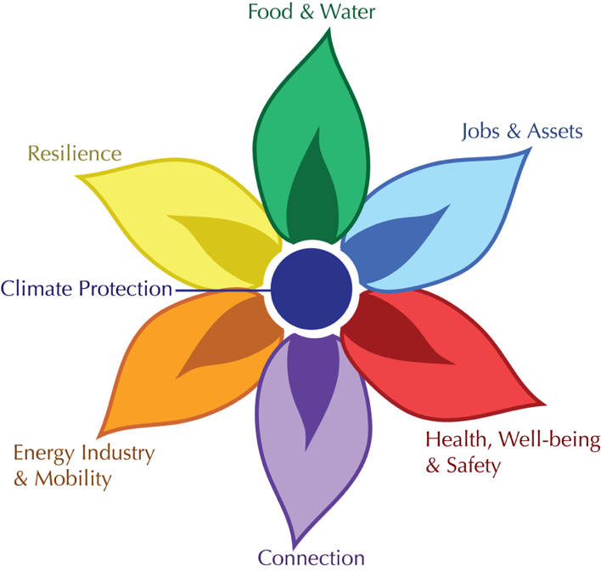
FLOWER
Framework for Long-term, Whole-system, Equity-based Reflection
Notes:
To assist in evaluating policies with benefits in multiple sectors, we developed the FLOWER tool
Health, Well Being & Safety:
improves mental, physical, and spiritual well being and creates safe conditions to live and work within
Jobs & assets:
provides meaningful work at a living wage and builds assets in a community
Food & Water:
increases access to healthy food and clean water
Resilience:
builds people’s capacity to survive or even thrive in the face of disruption
Energy & mobility:
brings people secure access to energy, the ability to make things they need, and the ability to get around
Connection:
leaves people more connected to each other and to the earth which sustains them, opening up new opportunities for multisolving

Slide 82


Slide 83


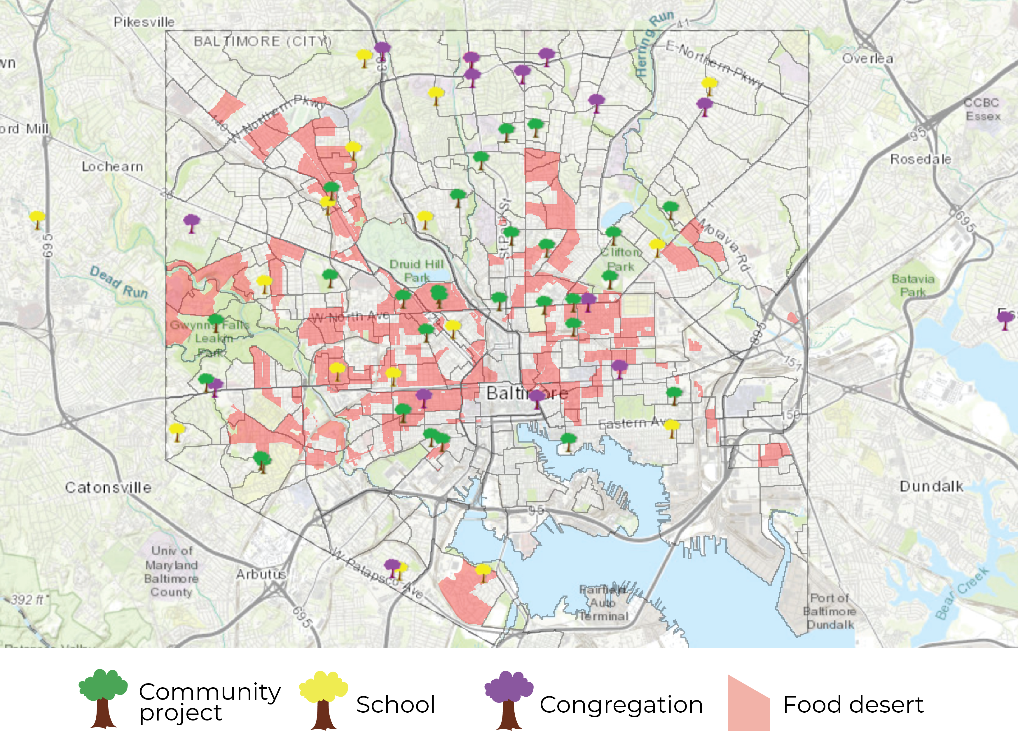

Baltimore Orchard Project
Planted over a thousand fruit and nut trees in nearly 100 orchards & harvested nearly 25 thousand pounds of produce.
Goals
  Improve food security
  Increase urban forestry canopy
  Build community ties
  Reduce flooding and runoff
Collaborators
  Civic Works
  TreeBaltimore
  Office of Sustainability
  Baltimore Gas & Electric
  Department of Public Works
Notes:
Program specifically created with environmental justice in mind. trees provide communities with a variety of social, economic, and environmental benefits. They reduce air pollution, store carbon dioxide, cool homes and nearby areas, mitigate storm water runoff, boost mental health, improve aesthetics, reduce crime rates, and more.

Slide 84
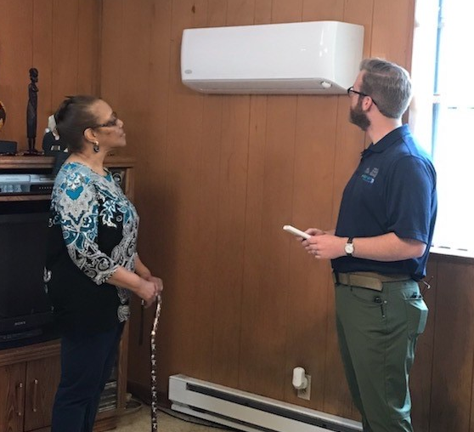

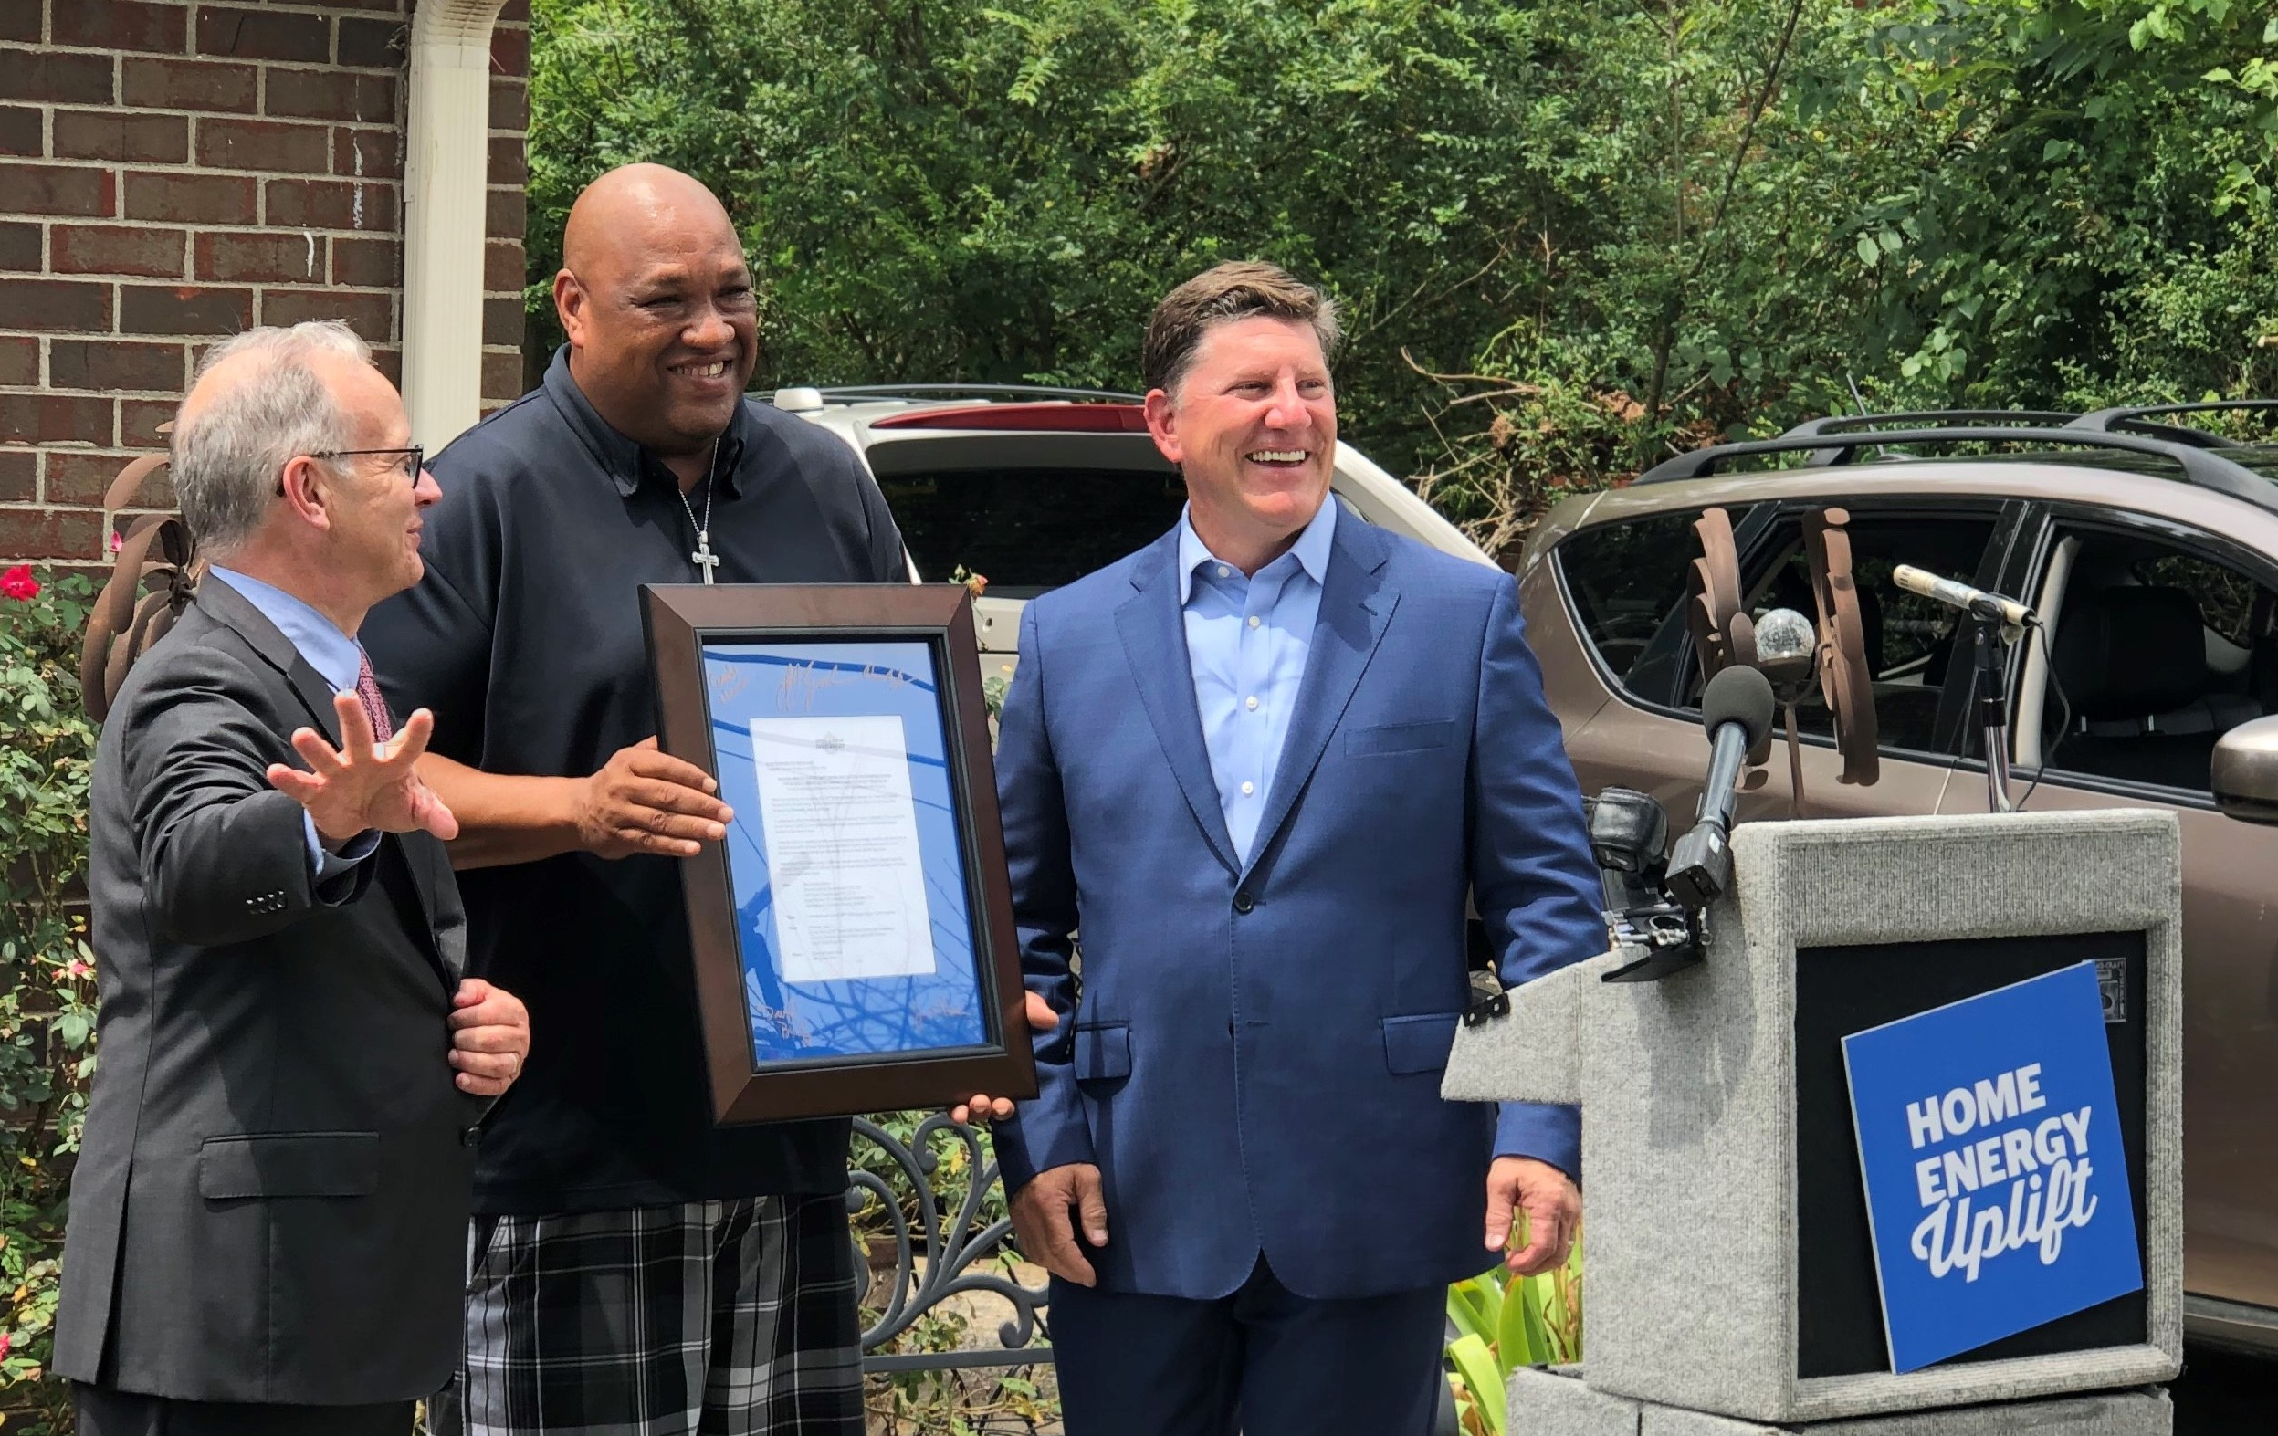
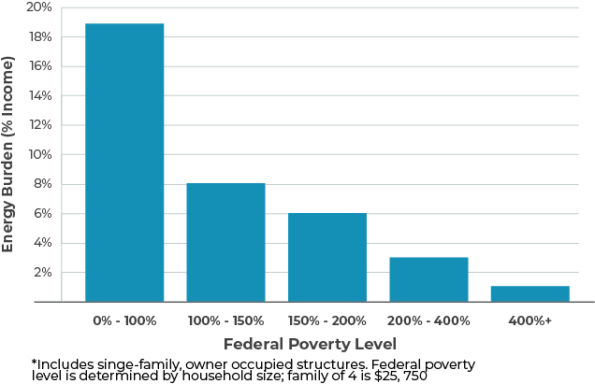
Nashville Home Uplift
Provides free energy efficiency for low-income residents. Designed to permanently improve overall quality of life.
Goals
  Reduce energy bills for low-income customers
  Improve health of residents
  Demonstrate non-energy benefits
Collaborators
  Nashville Electric Service
  Tennessee Valley Authority
  Office of Mayor David Briley
  AmeriCorps VISTA
Notes:
Home Uplift helps ease low-income homeowners’ energy burden through retrofits at no cost to residents. Home Uplift was implemented in specific locations within the Nashville Promise Zones, high poverty communities that receive government support to improve socio-economic outcomes. The coordinating organizations mapped the energy burdens of the Promise Zones to pinpoint zip codes with the greatest need and number of potential participants

Slide 85



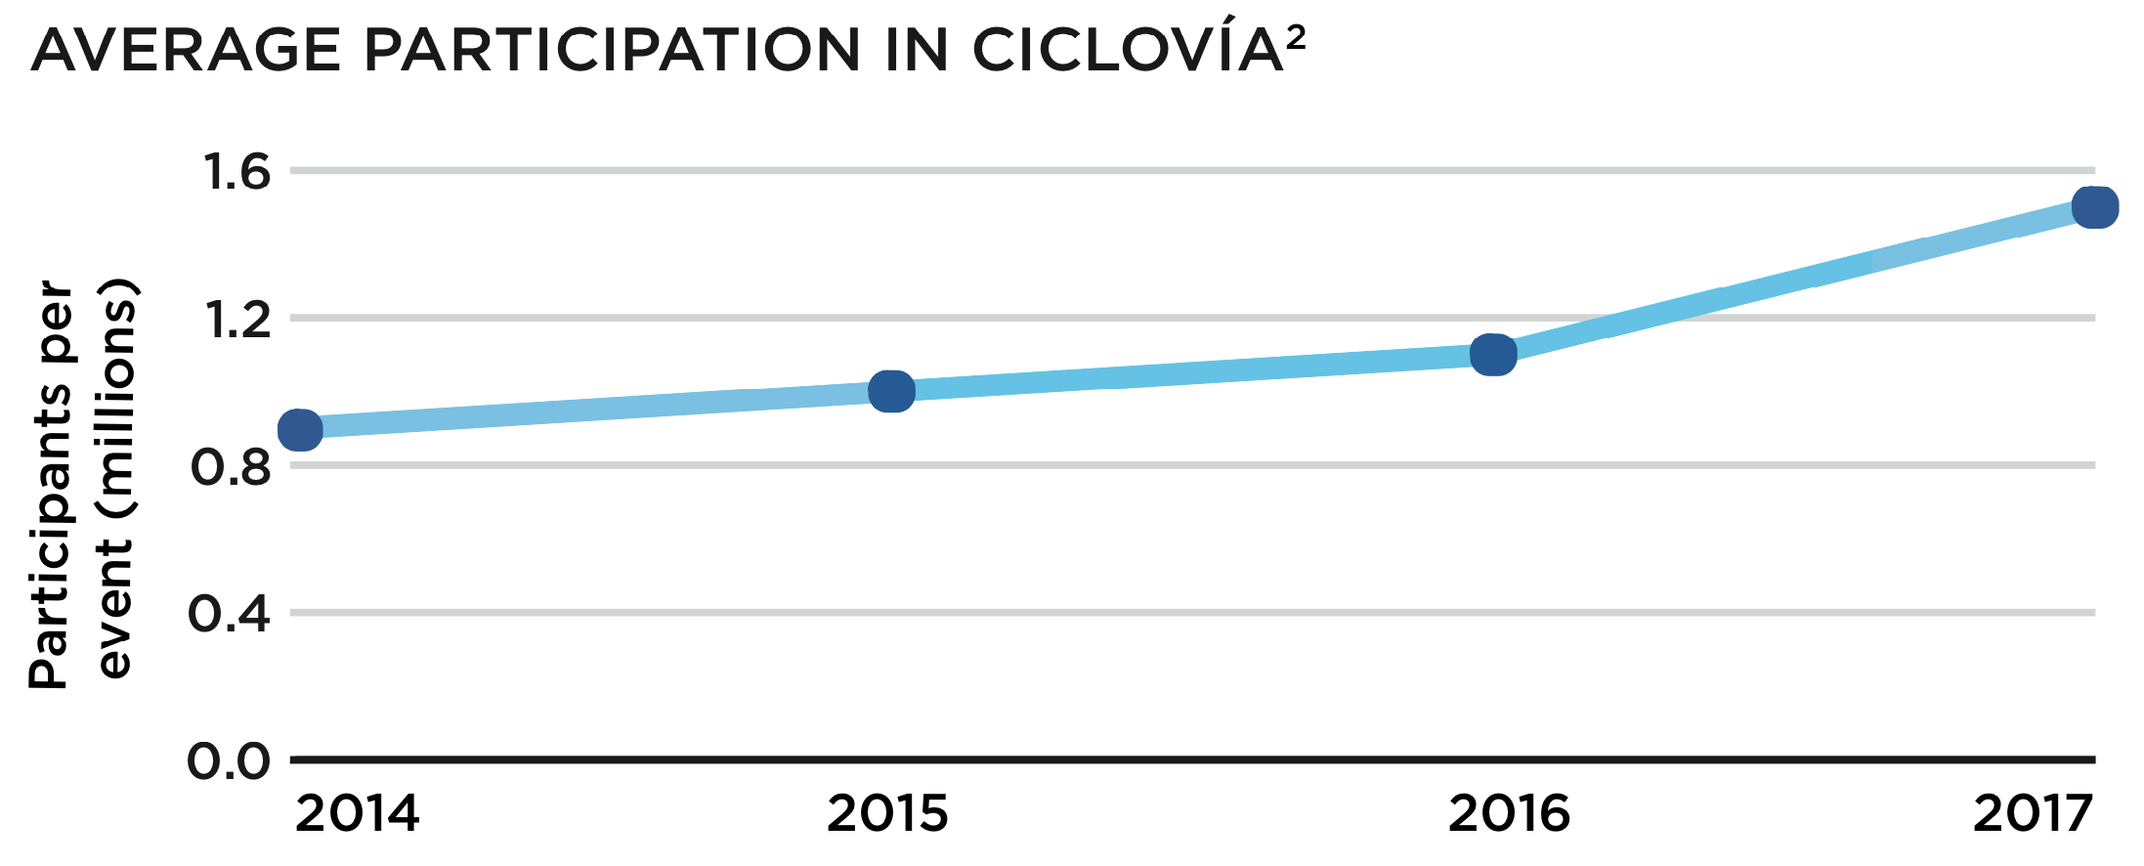
Ciclovía Bogotá
Closes 75 miles of roadways in Bogotá to cars on Sundays & holidays to encourage active transportation & increased physical activity, while reducing air pollution, noise, and CO₂ emissions.
Goals
  Promote physical activity & healthy habits
  Reduce CO₂ emissions
  Alleviate inequity
  Reduce noise levels
Collaborators
  District Institute of Recreation and Sport
  Health, Mobility, Education, and other Secretariats
  Police, volunteers, others
Notes:
20% of population participates
Services such as bike rental and repair, food vendors, vet booths, product vendors.
Other activities such as free yoga, dance, aerobics class (Recrovia)

Slide 86



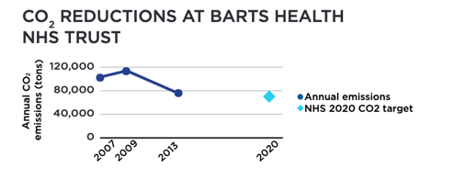
Operation TLC
Encourages hospital staff to close doors, turn off unused equipment, & lights. Saves money, strengthens the healing environment for patients, boosts staff productivity, & reduces CO₂ emissions.
Goals
  Save energy
  Reduce spending
  Reduce CO₂ emissions
  Demonstrate benefits from energy efficiency
Collaborators
  Queen Mary University
  Department of Health
  NHS Trust
  Hospital staff
  GE & Skansa

Slide 87

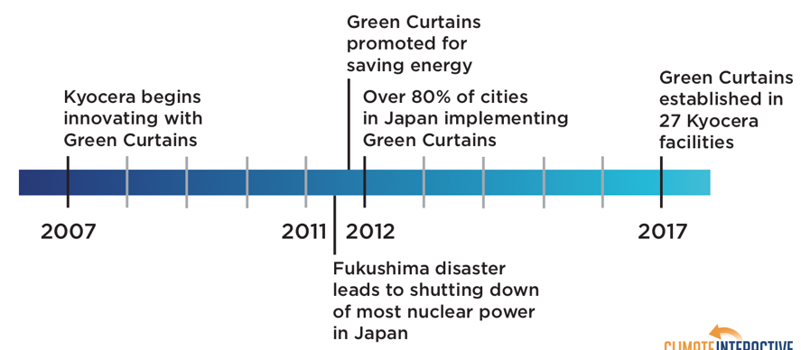
Green Curtains
Regulates indoor air temperatures, reduces energy use, promotes healthy diets, and reduces pollution by growing decorative and edible climbing plants on the exterior walls of buildings.
Goals
  Reduce energy consumption
  Promote healthy diets
  Reduce CO₂ emissions
Collaborators
  Kyocera, Japanese government, environmental NGOs, schools, restaurants, residents

Slide 88


London Transport Scenarios
More efficient engines and fuel switching.
Some car travel replaced with walking and cycling.
Reduction in transport CO₂ emissions:
35%
38%
Reduction in premature deaths per million people:
17
530
Source: Lancet 2009; 374: 1930–43
Notes:
Example of transport EE

Slide 89
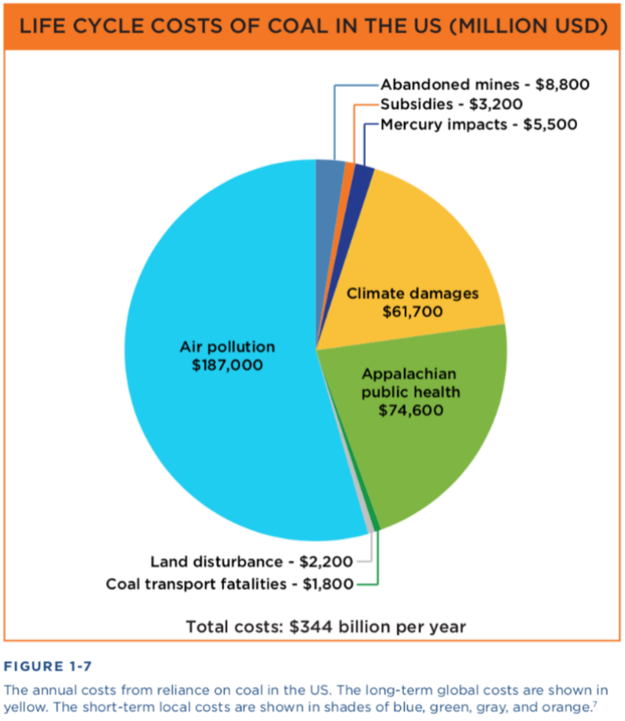
(Epstein, Paul R., Jonathan J. Buonocore, Kevin Eckerle, Michael Hendryx, Benjamin M. Stout III, Richard Heinberg, Richard W. Clapp, Beverly May, Nancy L. Reinhart, Melissa M. Ahern, Samir K. Doshi, and Leslie Glustrom. 2011. “Full Cost Accounting for the Life Cycle of Coal.” In Ecological Economics Reviews. Robert Costanza, Karin Limburg & Ida Kubiszewski, eds. Ann. N.Y. Acad. Sci. 1219: 73–98.)
Notes:
Example of air quality improvements

Slide 90


















Equity Considerations for En-ROADS
Energy Supply
Coal Taxing can raise energy costs. Low-income individuals who rely on coal jobs suffer the most negative impacts of its production. | Renewables Subsidy programs are often limited to homeowners, while poorer communities are unable to access the technology.
Oil Taxing can burden people who rely on oil for heating or transportation. Workers may need re-training | Nuclear Plants, mines, & waste sites often located in low-income areas that lack resources to advocate for stricter regulations.
Natural Gas Poor communities & communities of color disproportionately experience negative impacts of drilling and burning. | New Technology There are unknown consequences and risks associated with new energy sources.
Bioenergy Subsidizing may accelerate deforestation and can negatively impact farmer livelihoods by shifting agriculture markets. | Carbon Price Higher costs may be passed on to consumers. Corruption may lead to governments or companies taking advantage of revenues.
Transport
Energy Efficiency High-quality pedestrian & cycling infrastructure is often concentrated in wealthier, white communities. Improved public transportation can improve social equity. | Electrification Electric vehicles and charging stations may not be affordable or available to everyone. Mining battery materials like lithium and copper harms ecosystems.
Land and Industry Emissions
Deforestation Policies to reduce deforestation need local stakeholder engagement. Some preservation efforts have restricted the access of Indigenous people who have lived sustainably on the land for generations. | Methane & Other Policies to reduce methane & other gases may decrease food security. Cultural values are attached to many foods. Local economies and employment that rely on industrial agriculture can be threatened.
Buildings & Industry
Energy Efficiency Sometimes high up-front costs of efficiency improvements. Policies often directed to property owners, inhibiting low-income renters from accessing the benefits. | Electrification Sometimes high up-front costs of switching energy systems to electric. Household air pollution is unevenly distributed within and across countries
Carbon Removal
Afforestation Large shifts in land can compromise historic land access or compete with other needs for the same land, including food production. | Technological Many approaches have not yet been developed at scale and growing technological removal poses unknown risks and consequences to the communities they are situated within.
Growth
Population Policies around limiting population growth should be voluntary, accessible, & empower women to make the choices that are best for them. | Economic Growth Gains in GDP have disproportionately gone to the world’s wealthiest in recent decades. Policies must be tailored to an area’s specific circumstances.

Slide 91
Multisolving co-benefits for En-ROADS
Energy Supply
Coal Taxing coal can reduce air pollution, which can improve community & ecosystem health. | Renewables Subsidizing can reduce air & water pollution, improve health, productivity, savings, energy access, and job opportunities.
Oil Taxing reduces chance of harmful oil spills. Less oil demand can improve national security & lower military costs. | Nuclear Taxing can reduce the risk of exposure to radiation from nuclear meltdown or hazardous waste. Protects health of uranium miners.
Natural Gas Taxing can improve water security & quality, protects wildlife and biodiversity. | New Technology Research advancements in new technologies can create jobs and may be useful for other applications.
Bioenergy Taxing can free up land for other uses like food production and protect intact ecosystems. | Carbon Price Can improve air quality, healthcare savings, & worker productivity. Makes renewable energy relatively cheaper. Funds can be earmarked for social programs.
Transport
Energy Efficiency Increasing can lower total energy costs, improve public transit & reduce traffic congestion. More biking & walking increases physical activity and health. | Electrification Increasing creates jobs in manufacturing & sales of electric batteries & engines. Improves air quality at the source, which can increase health & worker productivity.
Land and Industry Emissions
Deforestation Reducing can decrease erosion, help protect biodiversity, ecosystems, & food sources. Also can preserve small-scale resource gathering & sustainable forestry livelihoods. | Methane & Other Reducing can improve water pollution & protect habitats. Plant-based diets are typically healthier for individuals and ecosystems.
Buildings & Industry
Energy Efficiency Increasing can reduce total energy costs, improve indoor air quality, & health, and create jobs. | Electrification Increasing creates jobs, can lower energy costs, & improve indoor & outdoor air quality.
Carbon Removal
Afforestation Increasing creates jobs in tree planting & care. Urban tree canopies reduce urban heat island effect which conserves energy. | Technological Growth in nature-based carbon removal approaches like agricultural soil sequestration may help improve small-holder and farmer profits.
Growth
Population Lower growth can reduce global consumption. Access to family planning, reproductive services, & education enhances quality of life for women. | Economic Growth Low growth can shift focus from material consumption to alternative measures of wellbeing such as gross national happiness.

Slide 92
Hope

Slide 93
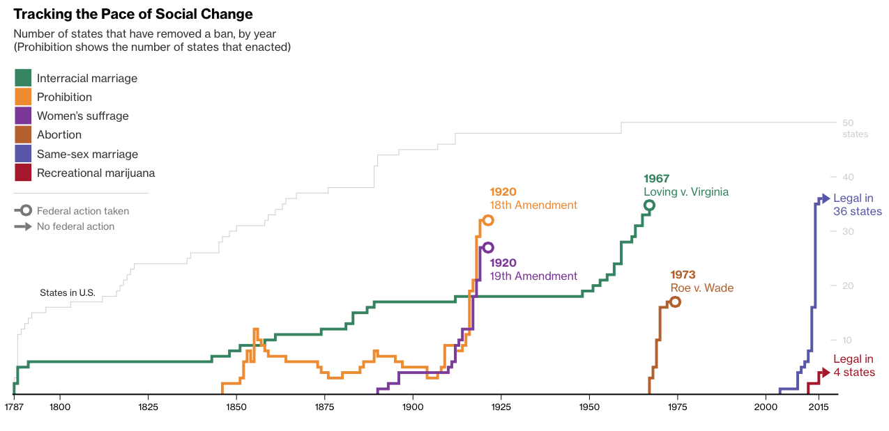
Social Change Looks Impossible Until it is Completed
Notes:
Source: http://www.bloomberg.com/graphics/2015-pace-of-social-change/

Slide 94
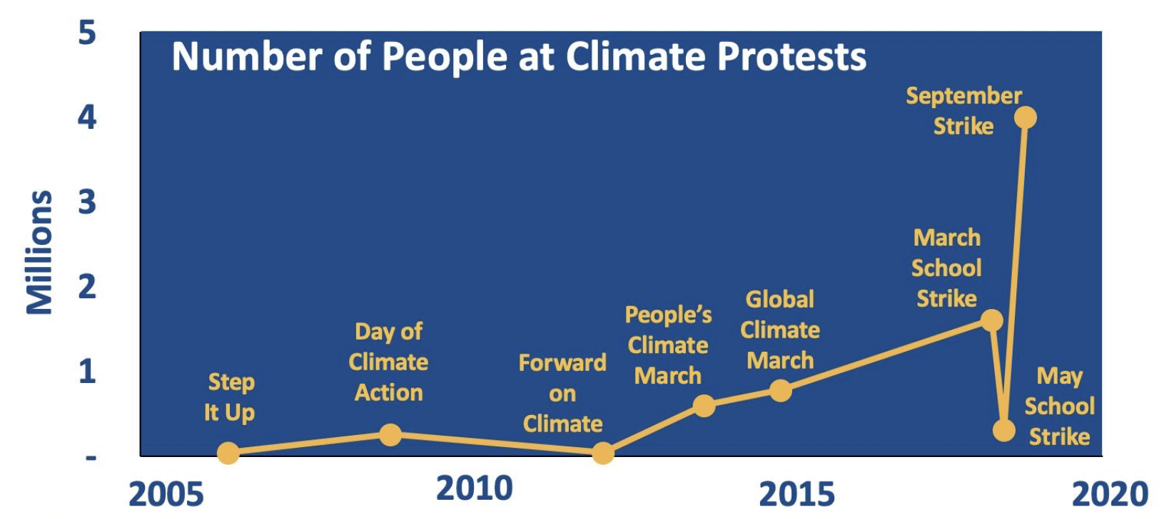

Slide 95
What can you do?
Learn En-ROADS and lead an experience in your community
Get actives as a citizen!
  Volunteer
  Visit your lawmakers
  March, protest, vote

Slide 96


Slide 97
More from
Climate Interactive

Slide 98
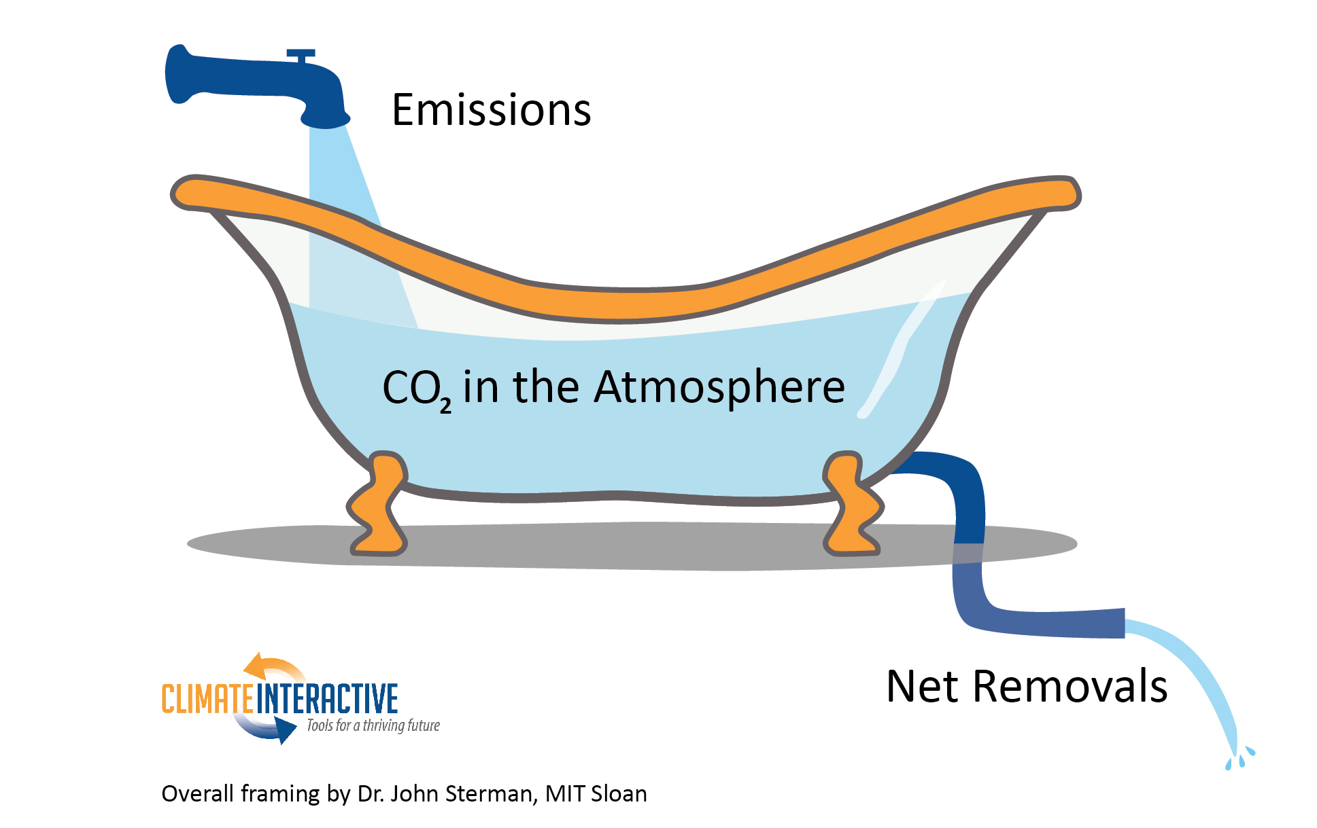

Slide 99
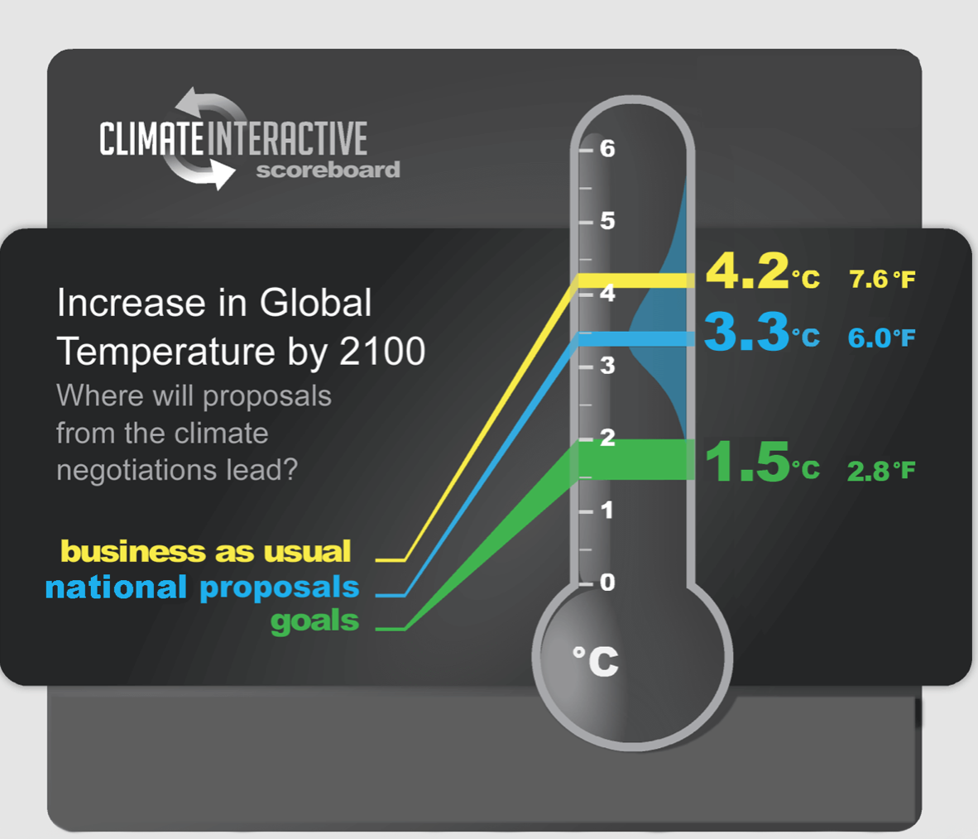

Slide 100
We Need Increased Climate Ambition

Slide 101
Climate Science

Slide 102
Balancing Feedback
Other Nutrient Limits
(N, P, K, Fe, H₂O,
Sunlight, etc.)

Slide 103
Reinforcing Feedback
Methane and
Methane and

Slide 104
More Reinforcing Feedbacks
Incidence and Severity of Wildfire
+
Length of Dry
Season
Atmospheric CO2 Concentration
Wildfire
+

Slide 105
More Reinforcing Feedbacks

Slide 106
Climate Impacts

Slide 107
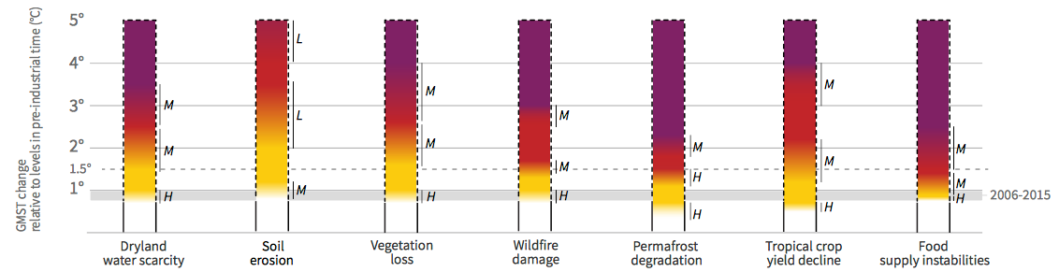

IPCC Special Report 2019: Climate Change and Land
°C above preindustrial level
Scale
Very high risks of severe/irreversible impacts, with limited ability to adapt
Significant, widespread impacts/risks
Detectable impacts/risks
No detectable impacts
5.0
4.0
3.0
2.0
1.5
1.0
0
Dryland
water scarcity
Soil
erosion
Vegetation
loss
Wildfire
damage
Permafrost
degradation
Tropical crop
yield decline
Food supply
instabilities
https://www.ipcc.ch/site/assets/uploads/2019/08/4.-SPM_Approved_Microsite_FINAL.pdf

Slide 108
Climate Economics

Slide 109
The Climate Dividend
Cutting emissions puts $$ in our pockets
  Reduces air pollution, improves public health, reduces inequity
  US: $75-280 Billion/year and 200,000 lives/year;
  Worldwide: $Trillions/year and 8 million lives/year
  Reduces need to defend insecure oil supplies, intervene in conflicts amplified by impacts of climate change (Priceless)
Investing in emissions reductions
  Stimulates innovation and new businesses
  Creates good jobs
  Opportunity for global leadership in critical emerging technologies
  Getting cheaper every day

